Slide 1

TEXPRESS
LANES:
A REGIONAL OVERVIEW

Slide 2
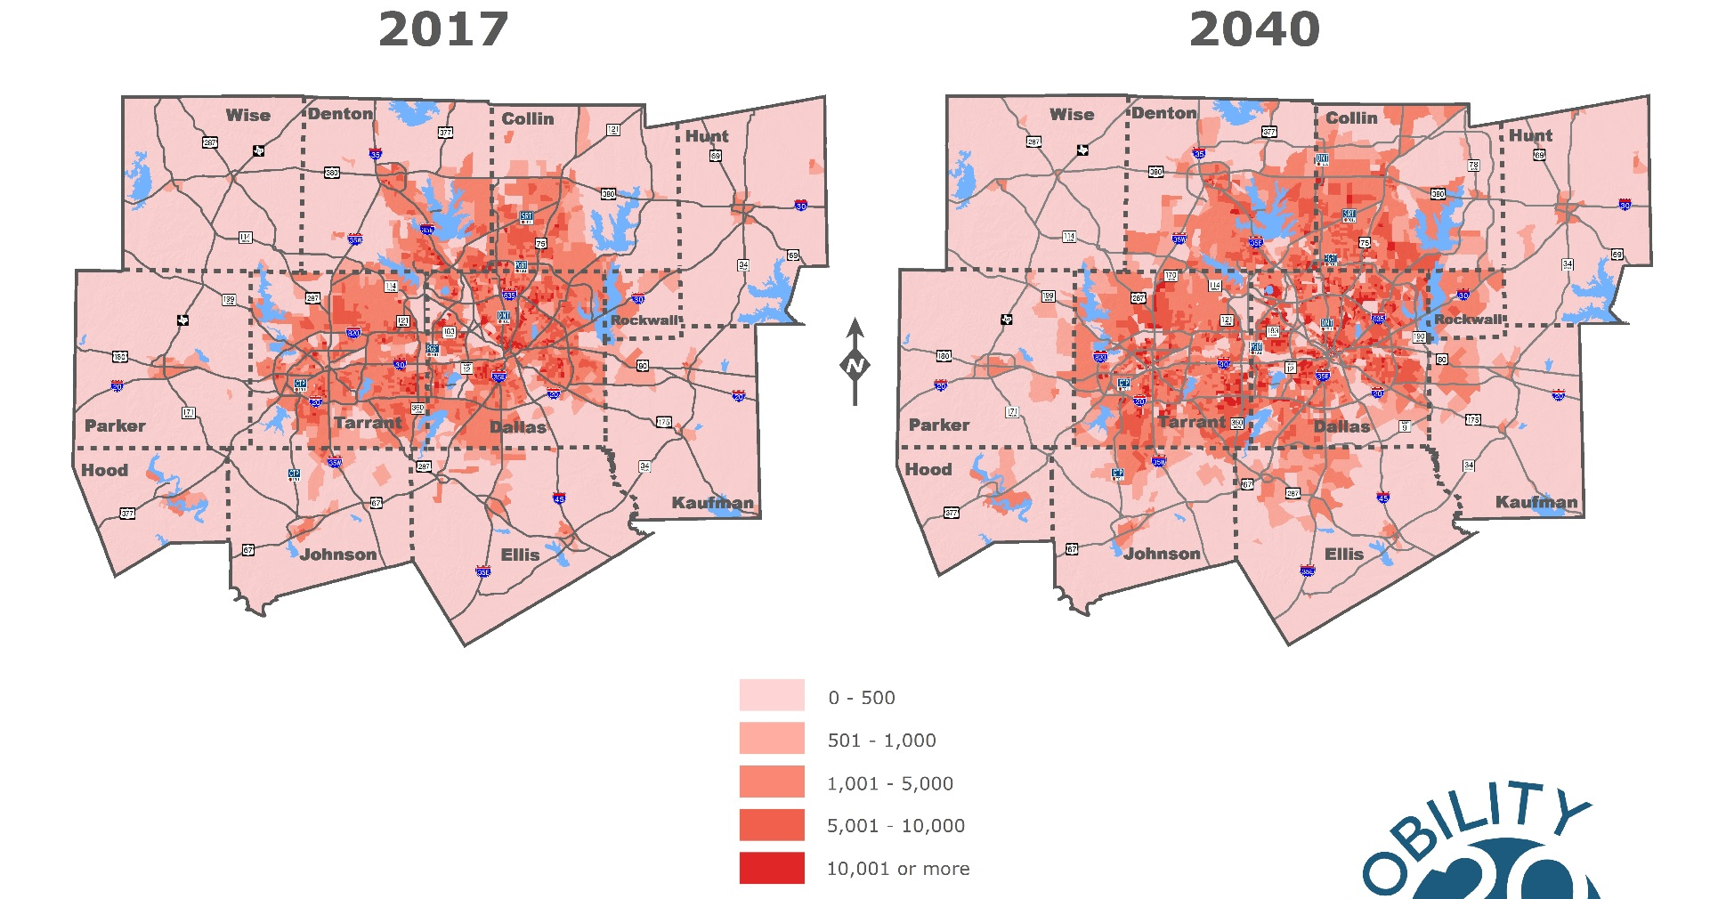
REGIONAL GROWTH
LEGEND
Change in Population Density 2017-2040
Population density in persons per sq. mi
Source: NCTCOG 2040 Demographic Forecast
The Dallas-Fort Worth area has more than 7 million people living in the 16-county region, and continues to add approximately 1 million new residents per decade.

Slide 3
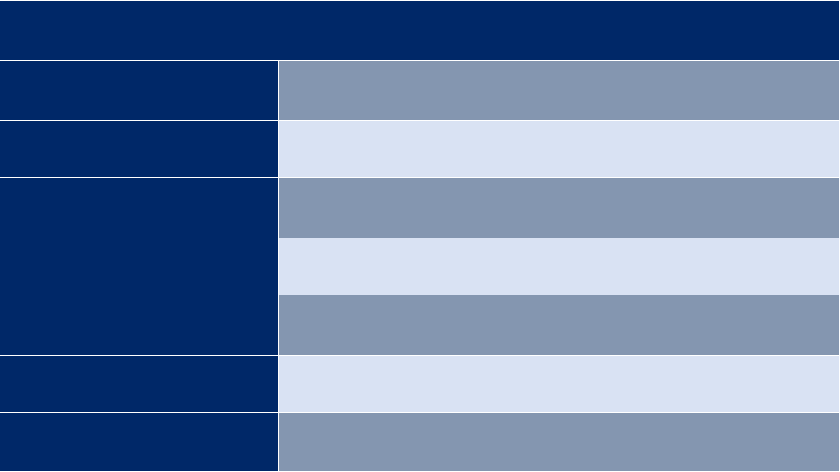
TEXPRESSLANES
ESTIMATED REGIONAL GROWTH
2017
2040
POPULATION
7,235,508
10,676,844
EMPLOYMENT
4,584,235
6,691,449
VEHICLE MILES OF TRAVEL
206,241,991
319,727,680
HOURLY CAPACITY
(MILES)
44,122,996
52,476,266
VEHICLE HOURS
SPENT IN DELAY
1,520,582
3,588,740
INCREASE IN TRAVEL TIME DUE TO CONGESTION
38.1%
58.2%
ANNUAL COST OF CONGESTION (BILLIONS)
$10.7
$25.3
Source: NCTCOG 2040 Demographic Forecast

Slide 4
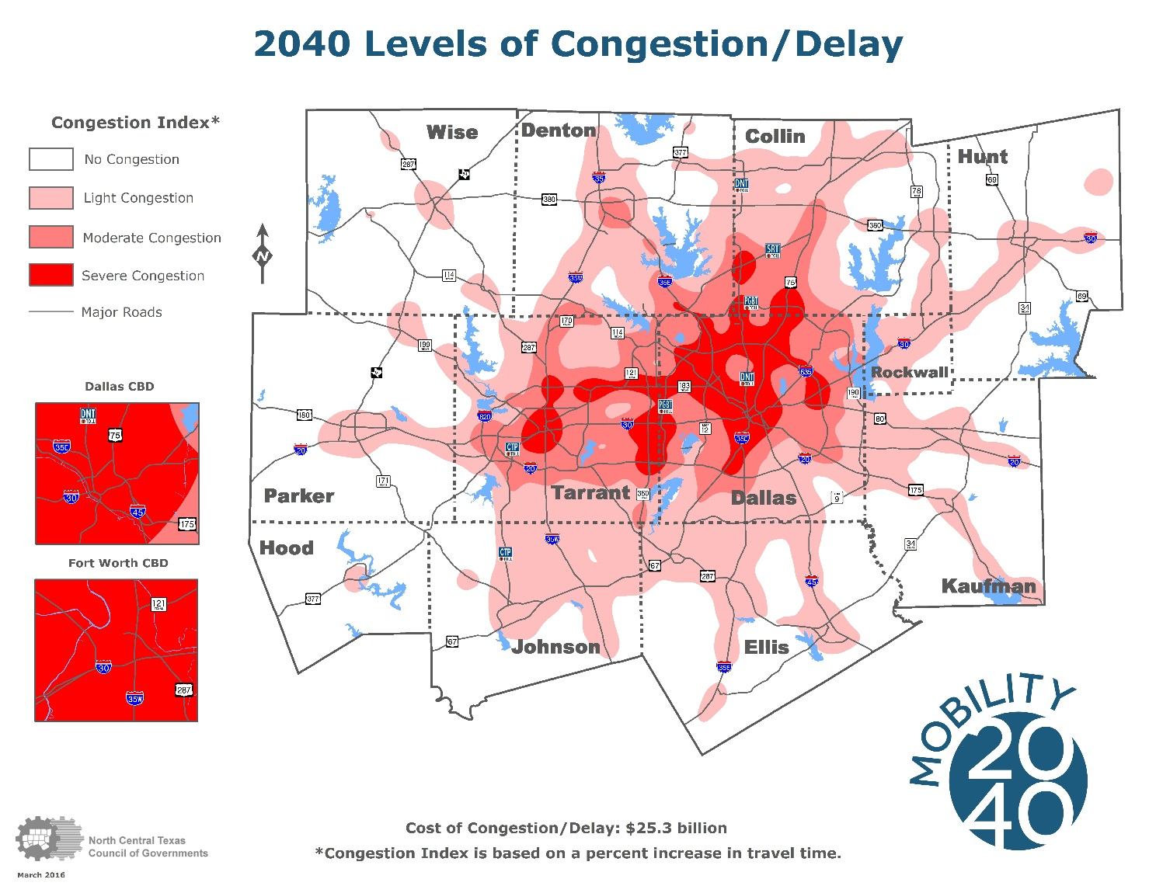
CONGESTION LEVELS
Source: NCTCOG 2040 Demographic Forecast
Current transportation funding is not keeping pace with the need to maintain and provide capacity improvements for the growing population, increasing congestion throughout the region.

Slide 5
TEXPRESSLANES
FUNDING CHALLENGES
State fuel taxes have not increased since 1991.
Federal fuel taxes have not increased since 1993.
The gas tax has lost much of its purchasing power and cannot sufficiently fund our roadways.
Increased construction costs
More
fuel-efficient vehicles

Slide 6
TEXPRESSLANES
LEVERAGE
PUBLIC SECTOR FUNDING
PRIVATE SECTOR CONTRIBUTION
PRIVATE TO PUBLIC SECTOR RATIO
TOLL ROADS
$1.6 Billion
$16.5 Billion
10:1
TOLLED MANAGED LANES
$1.3 Billion
$5.9 Billion
4:1
TOTAL
$2.9 Billion
$22.5 Billion

Slide 7
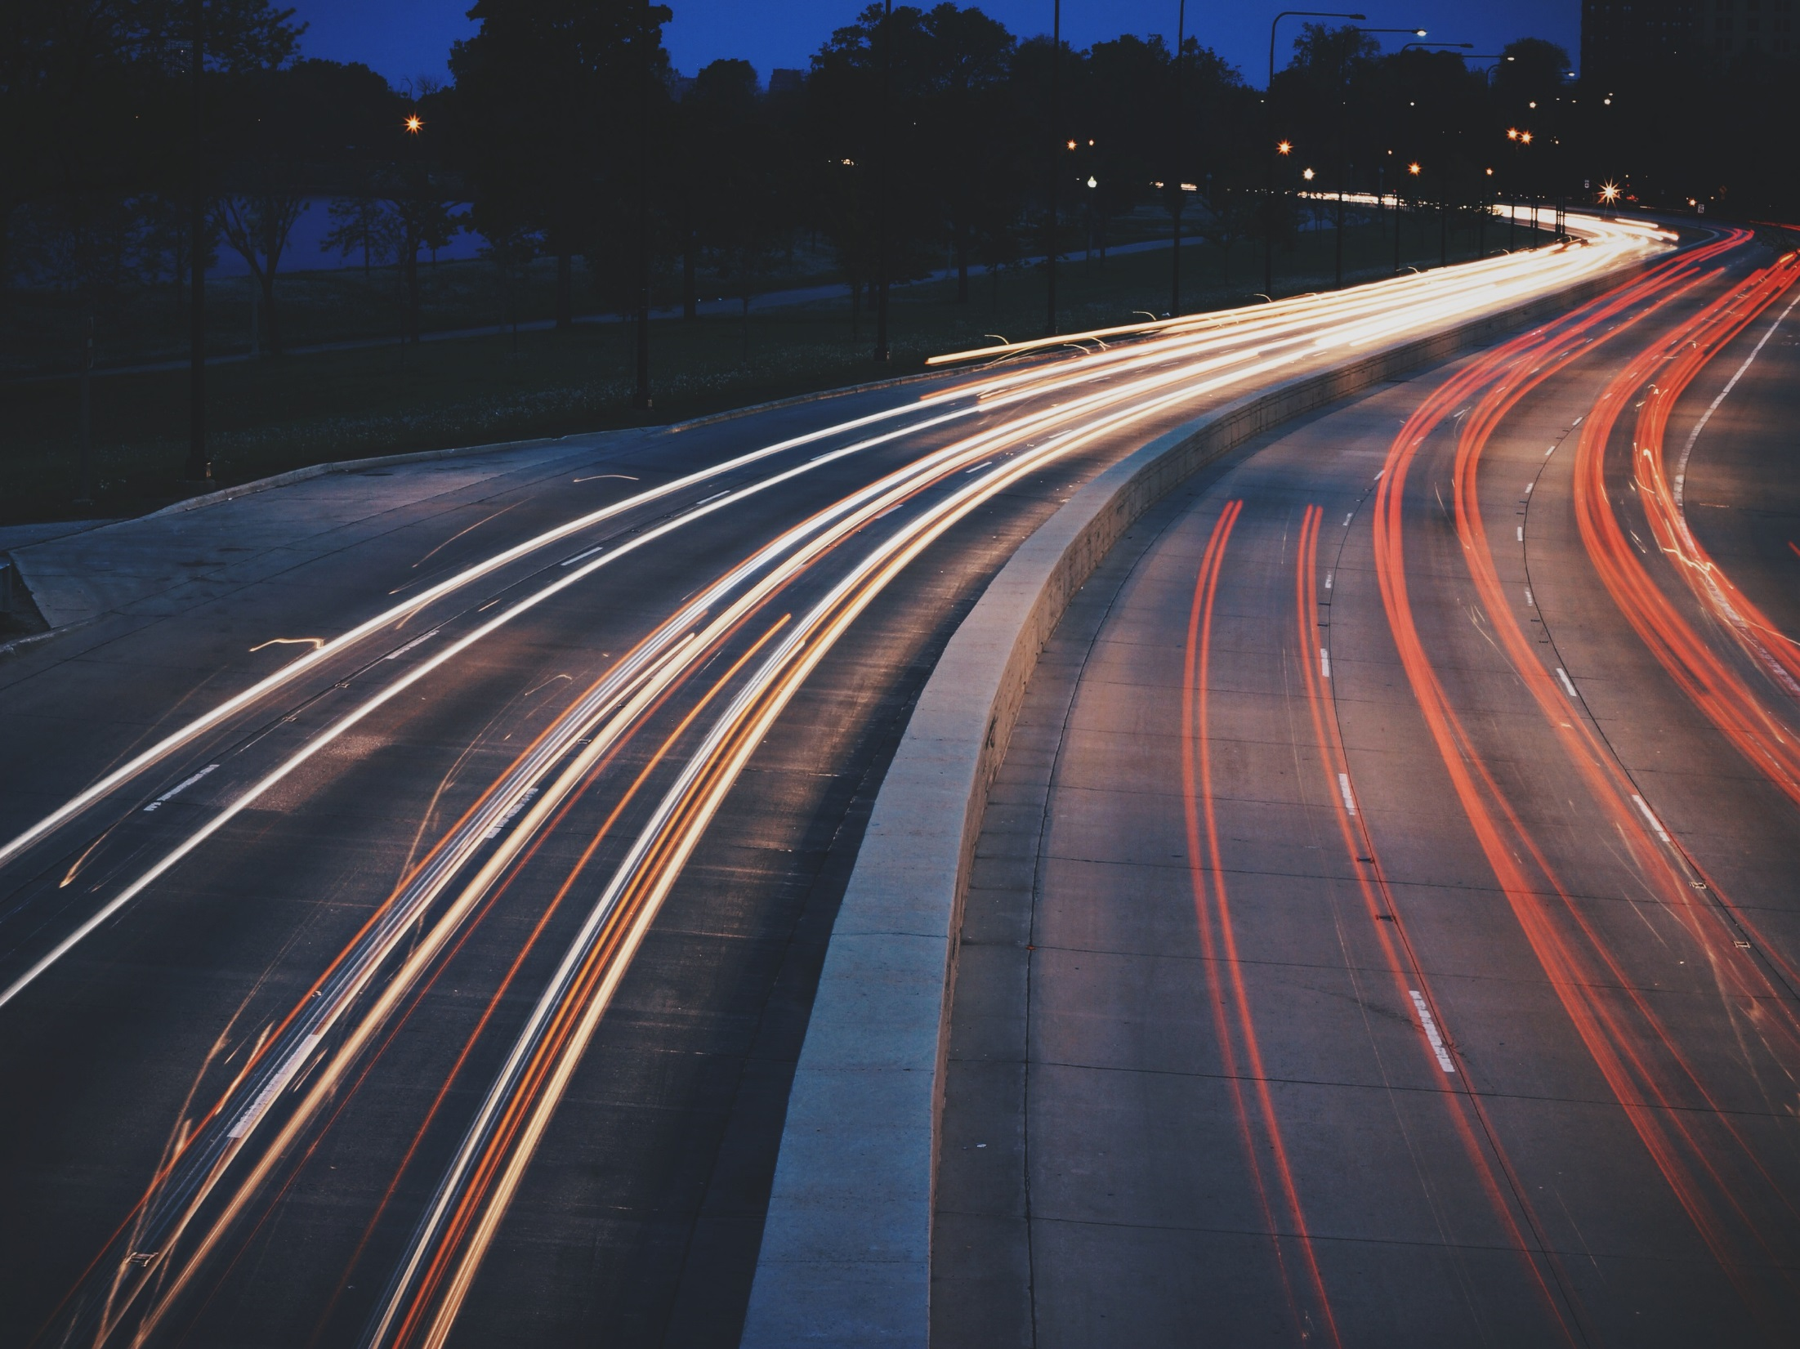
EXPLORING ALTERNATIVES
TEXpress Lanes expedite projects
Create extra capacity
Provide reliable travel times
Provide an option to drive on rebuilt, non-tolled lanes
Pay for their maintenance over time

Slide 8
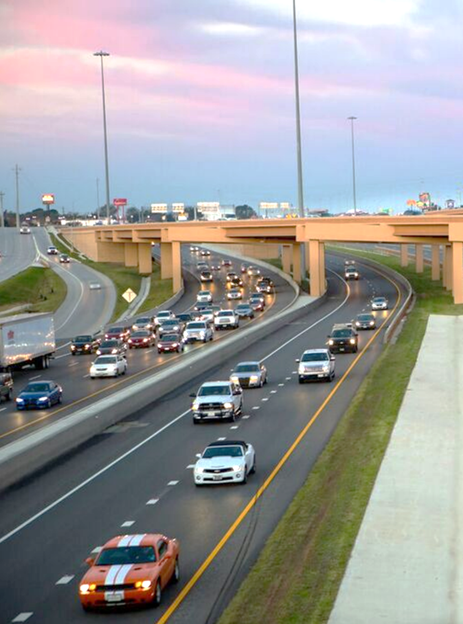
TEXPRESSLANES
WHAT ARE TEXPRESS LANES?
TEXpress Lanes are unique toll lanes that are built within an existing highway. They add additional capacity to the highway to accommodate more traffic to relieve congestion.

Slide 9
TEXPRESSLANES
HOW DO TEXPRESS LANES WORK?
Pricing on TEXpress Lanes is adjusted based upon the average speed and number of drivers on the TEXpress Lanes. Drivers are notified of the price they will pay on the toll pricing signs prior to entering any segment of the TEXpress Lanes.

Slide 10
NTE TEXPRESS USAGE FACTS
98%
1 in 5
$5-15
USE TEXPRESS AS-NEEDED
TRIPS ON TEXPRESS
BILL/MONTH
The average TollTag user chooses the TEXpress Lanes occasionally.
The average TollTag user chooses the TEXpress Lanes for 1 in every 5 trips.
Most drivers who choose the TEXpress Lanes have a bill between $5-$15 per month.

Slide 11
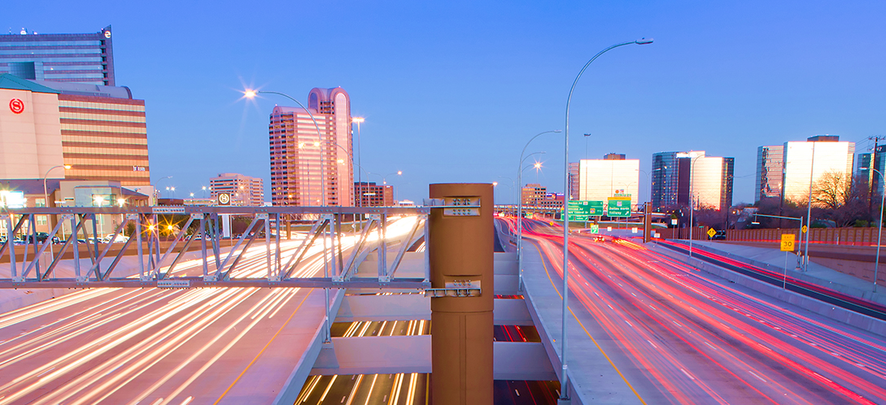

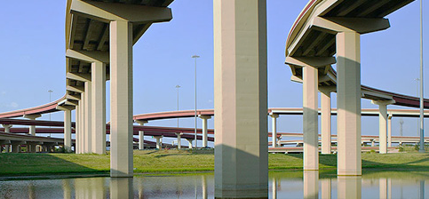
TEXPRESSLANES
TEXPRESS LANES
TEXpress Lanes add capacity alongside non-tolled lanes and use a pricing model with rates that fluctuate depending on traffic.
COMPARED TO
TOLL ROADS
NTTA toll roads charge standard, non-fluctuating toll fees.

Slide 12
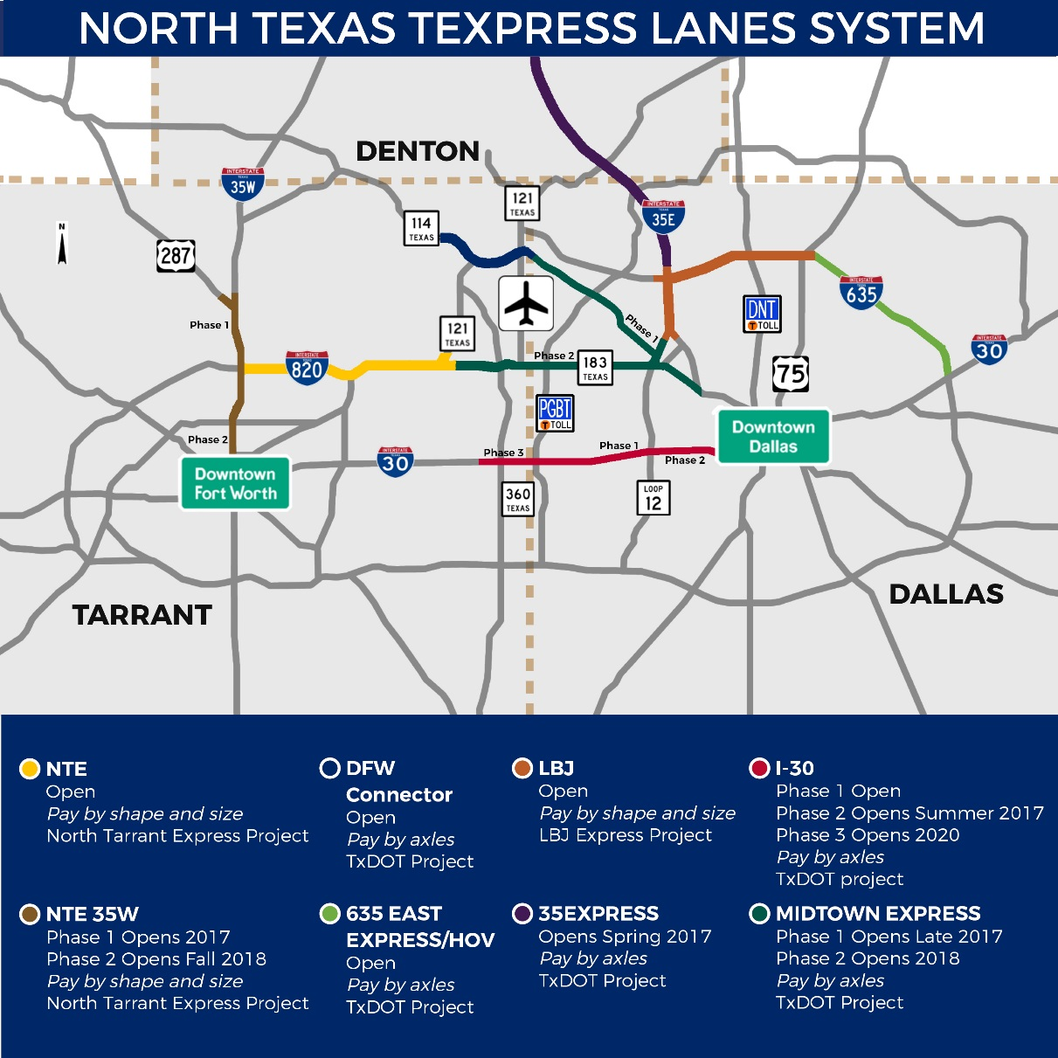
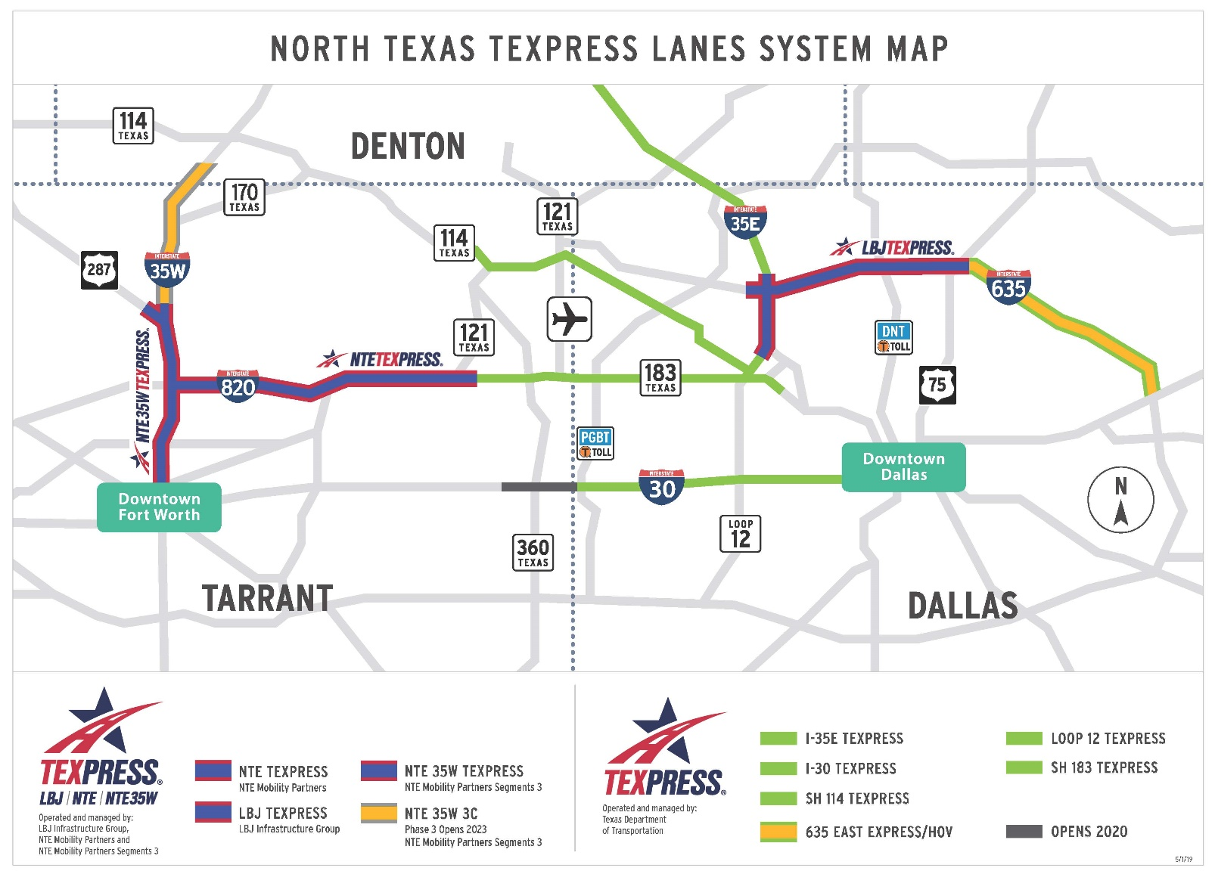
SYSTEM MAP
TEXPRESSLANES
TEXpress Lanes can be found throughout the region.

Slide 13
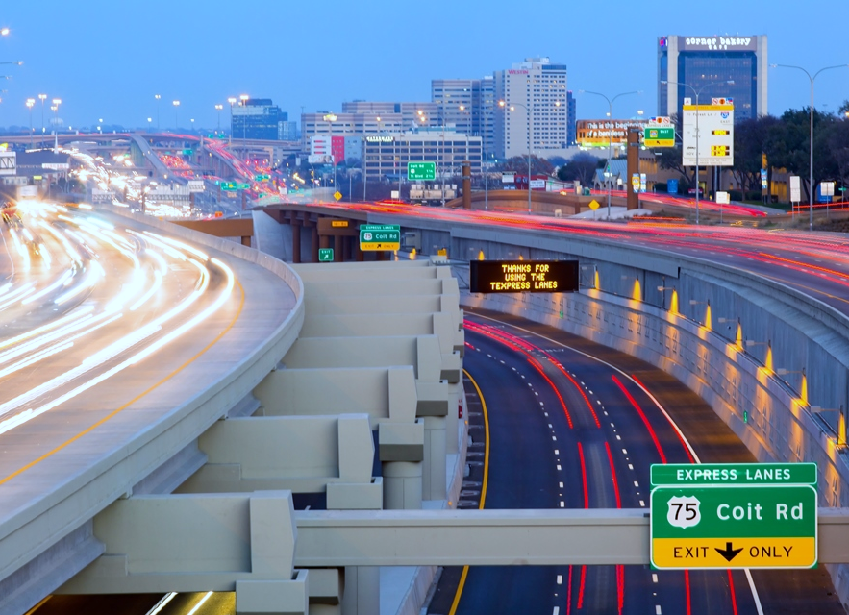
TEXPRESSLANES
CHOOSING
TEXPRESS
Drivers can always choose to drive the existing non-tolled lanes or choose TEXpress Lanes.

Slide 14




TEXPRESSLANES
CHOOSING TEXPRESS
TEXpress Lanes are designed for drivers who want a reliable and time-saving trip to reach many destinations.
WORK
HOME
SPORTS
AIRPORT
Drivers can make the best choice for them based on their own needs each time they drive on a roadway with TEXpress Lanes.

Slide 15
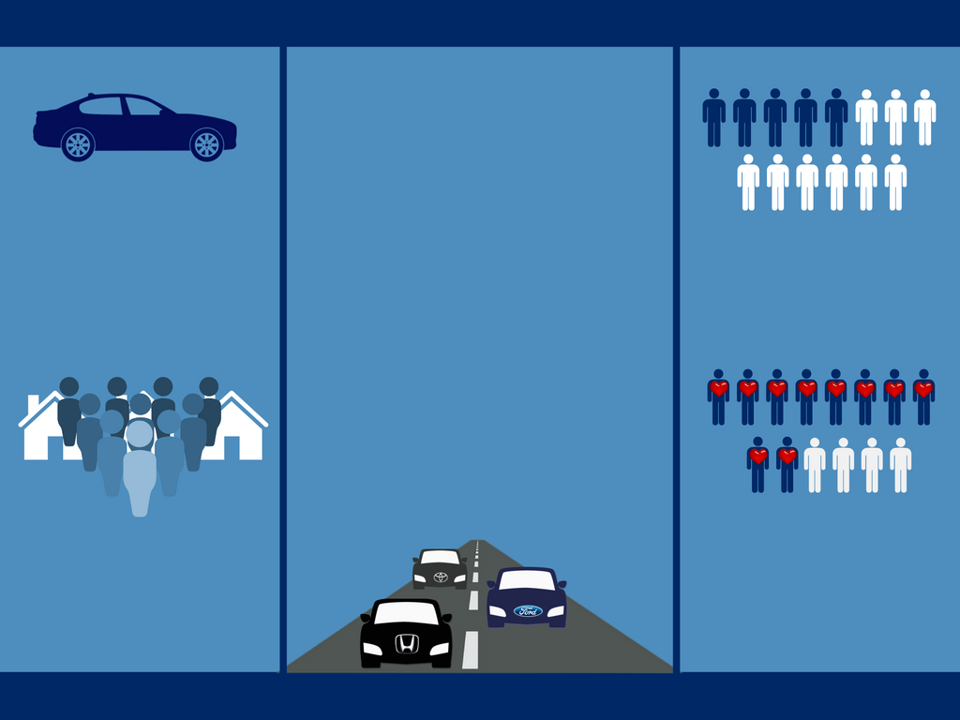
TEXpress
Lanes
6+ million different vehicles have used the LBJ & NTE TEXpress Lanes to date
are for everyone
5 in 14 users are new to TEXpress Lanes each month.
The most common carmakers seen on TEXpress Lanes are Toyota, Ford, and Honda
Only 15% of cars on TEXpress Lanes are luxury brands
More than 10 in 14 users view TEXpress Lanes favorably
7 million people live in Dallas-Fort Worth
Source: LBJ TEXpress and NTE TEXpress Lanes

Slide 16




TEXPRESSLANES
BENEFITS
$
$
$
$
REDUCES CONGESTION
ECONOMIC DEVELOPMENT
AIR QUALITY

Slide 17
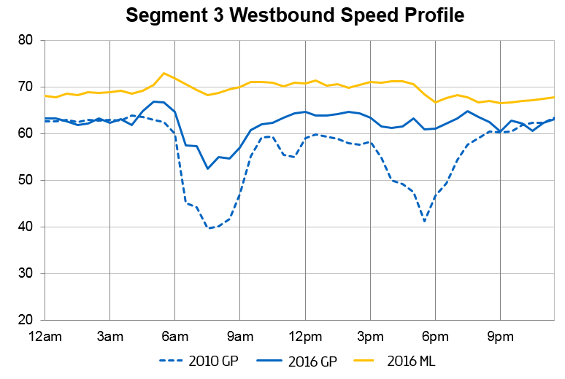
TEXPRESSLANES
REDUCES CONGESTION
TEXpress Lanes allow for expanded capacity without reducing efficiency.
Average speed increased by 10-15% in the LBJ corridor.
Congestion time on non-tolled lanes reduced by 60%.
2010 Non-Tolled Lanes
2016 Non-Tolled Lanes
2016 TEXpress Lanes

Slide 18
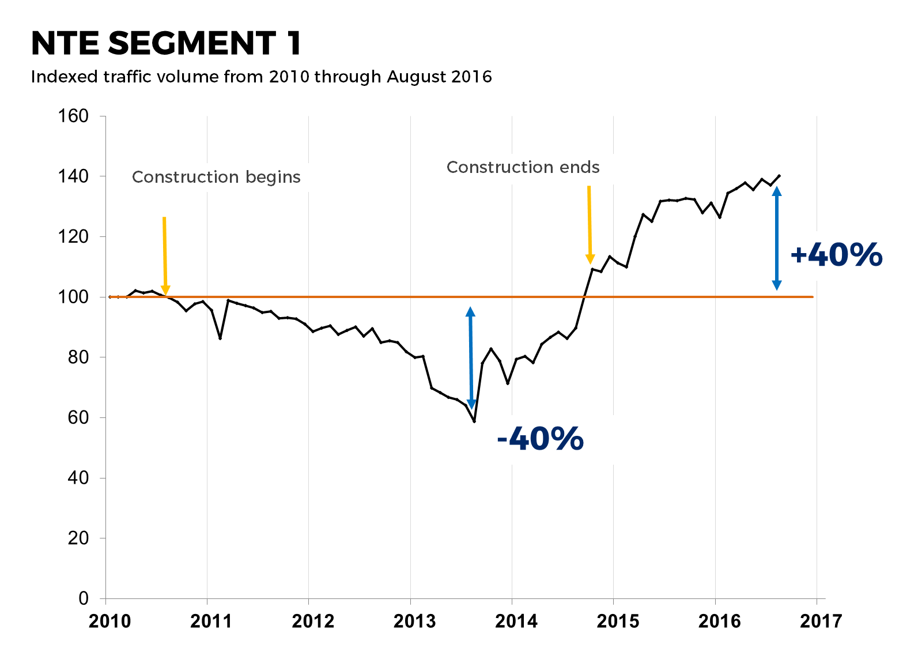
TEXPRESSLANES
REDUCES CONGESTION
NTE corridor traffic totals increased 40% since construction ended, while congestion time on non-tolled lanes has been reduced.

Slide 19
TEXPRESSLANES
ECONOMIC DEVELOPMENT
Improved transportation corridors bring:
Economic development
Increased property values
Additional tax revenues

Slide 20


TEXPRESSLANES
AIR QUALITY
Less stop-and-go traffic conditions help reduce emissions, helping improve air quality.

Slide 21
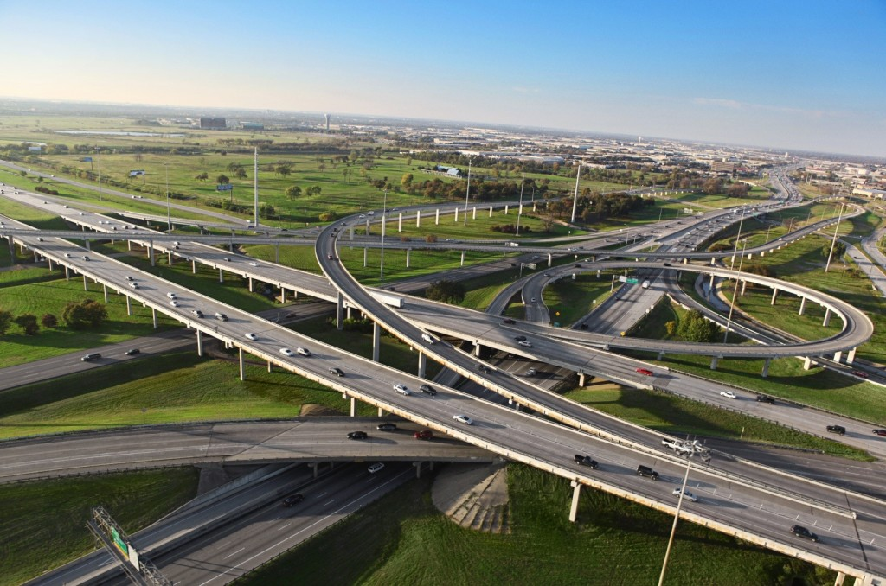

It’s all about drivers who want a more reliable commute.
TEXpress Lanes are a needed choice for North Texas residents.
TEXPRESSLANES.COM

