Slide 1
NCTCOG
2022 TITLE VI PROGRAM AND LANGUAGE ASSISTANCE PLAN UPDATES
REGIONAL TRANSPORTATION COUNCIL
5.12.2022

Slide 2
TITLE VI OF THE CIVIL RIGHTS ACT OF 1964
WHO IS PROTECTED
WHO MUST COMPLY
Prohibits discrimination on the basis of race, color, or national origin
Any program or activity that receives federal funds or other federal assistance
REGIONAL TRANSPORTATION COUNCIL

Slide 3
TITLE VI PROGRAM: METROPOLITAN PLANNING ORGANIZATION
FREQUENCY
CONTENTS
REVIEW
Update every three years
Describe how NCTCOG MPO implements Title VI nondiscrimination efforts and monitors subrecipients
Submit to Federal Transit Administration for review
REGIONAL TRANSPORTATION COUNCIL

Slide 4
TITLE VI/NONDISCRIMINATION POLICY STATEMENT
The North Central Texas Council of Governments (NCTCOG), as a recipient of federal financial assistance and under Title VI of the Civil Rights Act of 1964 and related statutes, ensures that no person shall on the grounds of race, religion, color, national origin, sex, age, or disability be excluded from participation in, be denied the benefits of, or otherwise be subjected to discrimination under any Agency programs or activities.
REGIONAL TRANSPORTATION COUNCIL
4

Slide 5
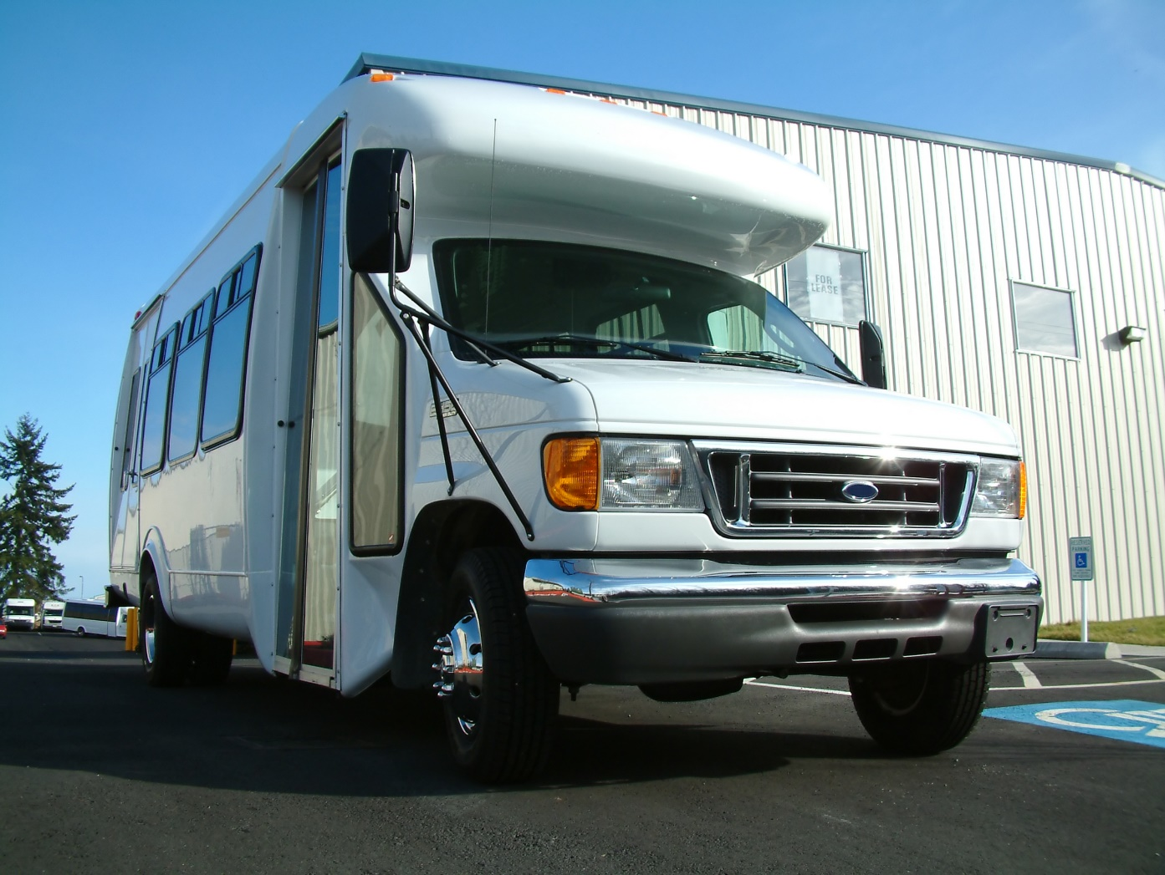
TITLE VI PROGRAM UPDATES OF NOTE
List of transit-related Title VI investigations, complaints, and lawsuits (none)
Summary of outreach efforts made since the last Title VI Program submission
Schedule of subrecipient Title VI Program submissions
Impacts of the distribution of state and federal funds in the aggregate for public transportation projects
Forty-five-day public comment period
Image Provided By Getty
REGIONAL TRANSPORTATION COUNCIL
5

Slide 6
LANGUAGE ASSISTANCE PLAN UPDATES OF NOTE
Limited English proficiency population for the 12-county Dallas-Fort Worth Metropolitan Planning Area
Literacy rates for the 12-county area
Four-factor analysis to evaluate the extent to which language assistance measures are required
Forty-five-day public comment period
Image Provided By Getty
REGIONAL TRANSPORTATION COUNCIL
6

Slide 7
TIMELINE
Meeting/Task | Date
Public Meeting, Launch of 45-Day Public Comment Period | February 7, 2022
Close of Public Comment Period | March 23, 2022
STTC Information | March 25, 2022
RTC Information | April 14, 2022
STTC Action – Title VI/Nondiscrimination Policy Statement, Title VI Program, Language Assistance Plan | April 22, 2022
RTC Action – Title VI/Nondiscrimination Policy Statement, Title VI Program, Language Assistance Plan | May 12, 2022
Executive Board | May 26, 2022
Submittal Deadline | May 31, 2022
REGIONAL TRANSPORTATION COUNCIL

Slide 8
REQUESTED ACTION
Regional Transportation Council approval of:
Title VI/Nondiscrimination Policy Statement
Updates to MPO Title VI Program
Updates to MPO Language Assistance Plan
REGIONAL TRANSPORTATION COUNCIL
8

Slide 9
CONTACT US
Ken Kirkpatrick
General Counsel
kkirkpatrick@nctcog.org | 817-695-9278
Kate Zielke
Principal Transportation Planner
Title VI Coordinator
kzielke@nctcog.org | 817-608-2395
REGIONAL TRANSPORTATION COUNCIL
9

