Slide 1
EQUITABLY REDUCING GREENHOUSE GAS EMISSIONS THROUGH ENERGY STRATEGIES
TRANSPORTATION
LAUREN JOHNSON|’21 EDF CLIMATE CORPS FELLOW|8.24.2021

Slide 2
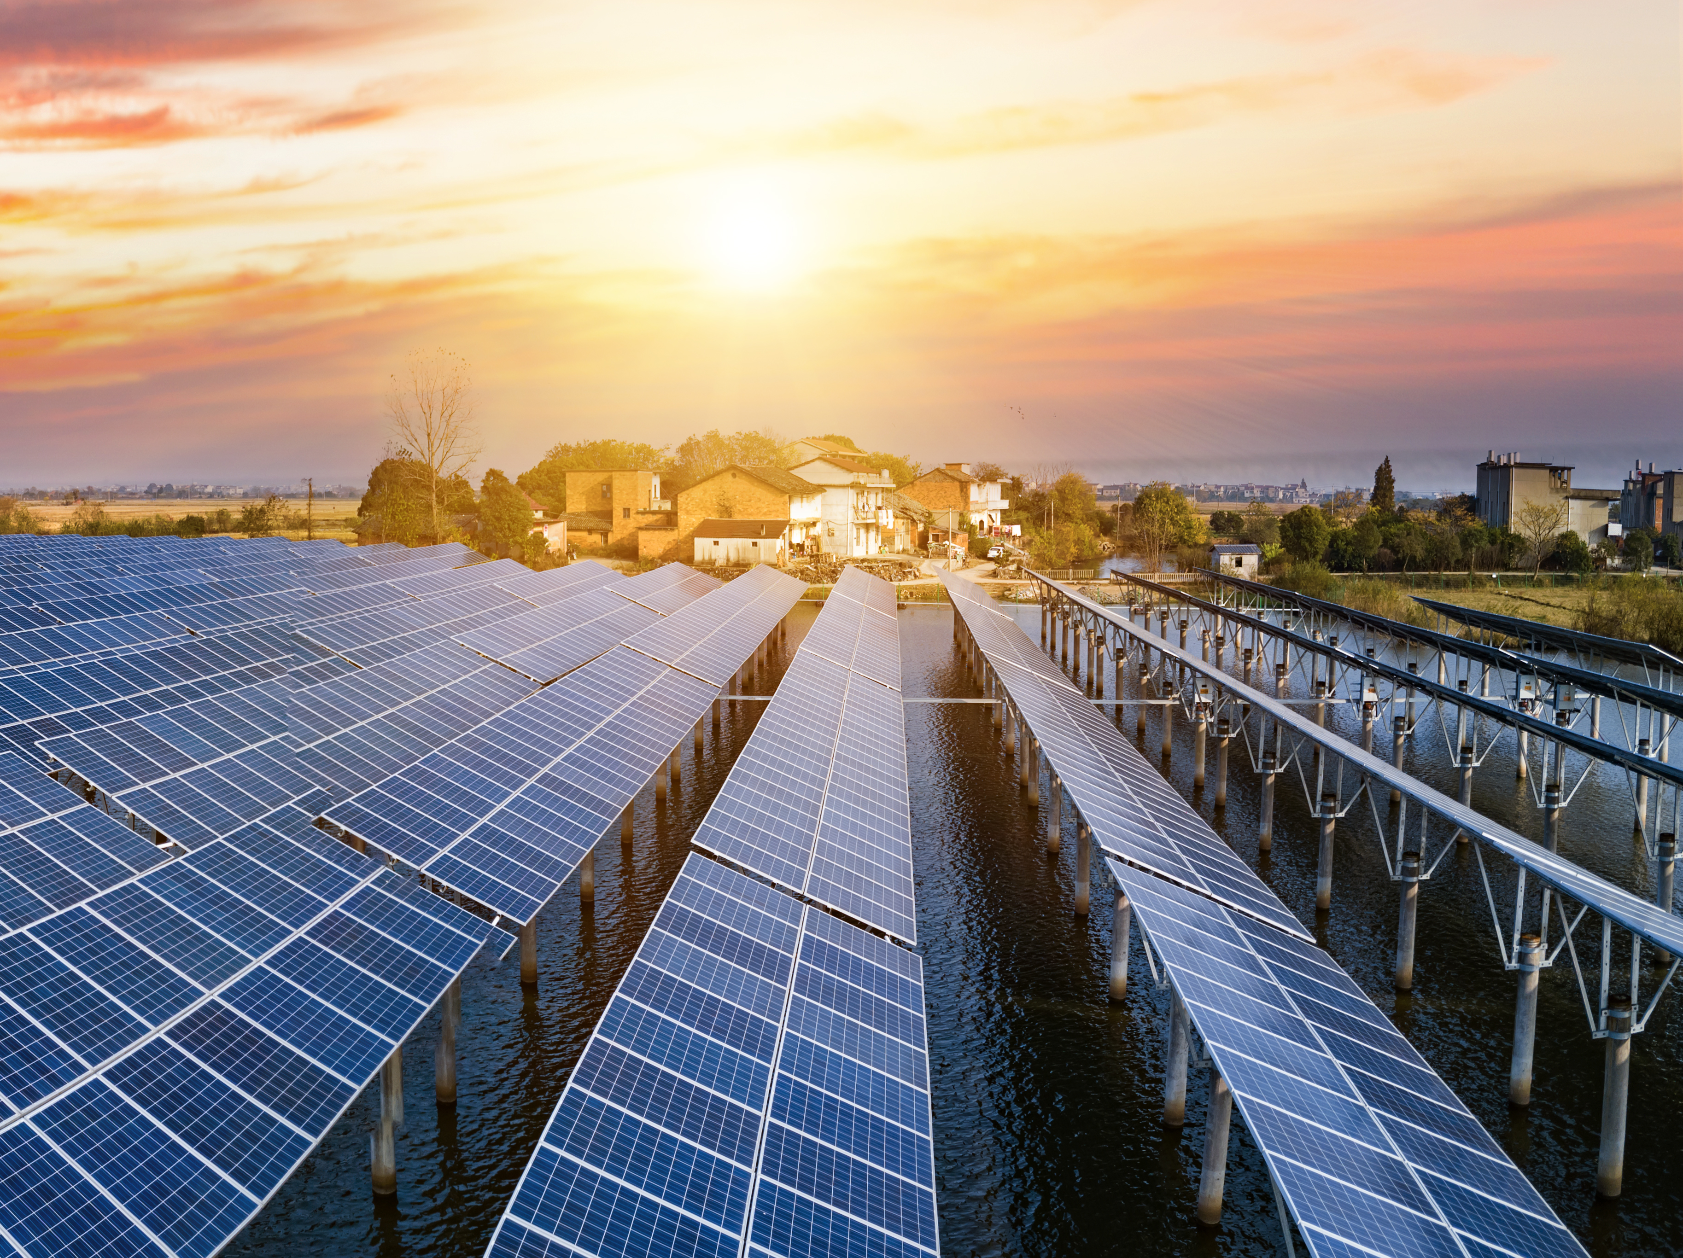
TABLE OF CONTENTS
INTRODUCTION
  Greenhouse Gases
  Climate Risk in DFW
LEADING WITH EQUITY
  Equity Analysis
  Equity Solutions
RESEARCH
  Analysis
  Criteria
STRATEGIES
  Energy Strategies
CONCLUSION
  Next Steps
  Conclusion
Image Provided By Getty ( source for external images only)

Slide 3
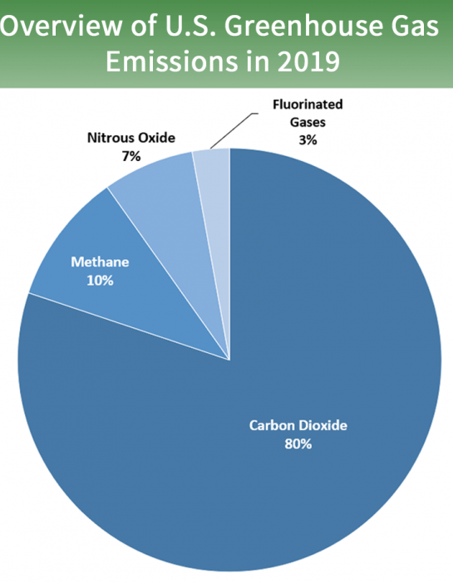
GREENHOUSE GASES
The U.S. Environmental Protection Agency (EPA) defines greenhouse gases (GHG) are gases that trap heat in the atmosphere.
The main greenhouse gases in our atmosphere are carbon dioxide (CO2), methane (CH4), nitrous oxide (N2O), and fluorinated gases.
Resources Provided By
3
Notes:
Citation: https://www.epa.gov/ghgemissions/overview-greenhouse-gases
As you can see the main greenhouse gas in our atmosphere is carbon dioxide.
CO2 emissions are primarily produced through the burning of fossil fuels, such as coal, natural gas, and oil, but can also be produced from solid waste, biogenic sources (trees and other biological materials), and from certain chemical reactions like the production of cement.
That is why reducing CO2 emissions is the main focus of this toolkit because it makes up 80% of total emissions and is primarily produced through human activities that produce emissions that lead to planetary warming through the greenhouse effect.
In fact the Intergovernmental Panel on Climate Change made up of thousands of leading climate scientists concludes that human activities are almost all responsible for the increase in greenhouse gases in the atmosphere throughout the last 150 years.
Citation: Solomon S, Qin D, Manning M, et al. Summary for policymakers. Climate change 2007: the physical science basis Contribution of Working Group I to the Fourth Assessment Report of the Intergovernmental Panel on Climate Change. Published online 2007:1-18.

Slide 4
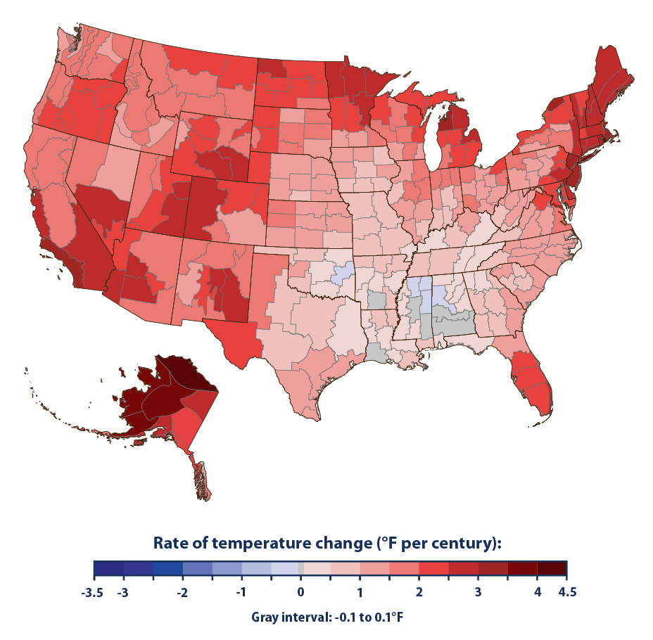
GREENHOUSE GASES IN TEXAS
Higher temperatures → hotter summers
Extreme rainfall
Mean rainfall and severe thunderstorms would increase by up to 10% and 40% respectively in the spring
  Higher flooding risk
More tropical storms occurring in the Fall
  Greater infrastructure damage
Source: U.S. EPA
zoom
Source: U.S. EPA
Notes:
Citation: https://www.epa.gov/ghgemissions/overview-greenhouse-gases, https://www.epa.gov/climate-indicators/climate-change-indicators-us-and-global-temperature
Once excess CO2 emissions are added into the atmosphere, they lead to a cascade of effects within our ecosystem. These include intensifying the water cycle by bringing more intense rainfall and flooding and simultaneously worse drought in other regions, affecting rainfall patterns by increasing rainfall in high latitudes and decreasing it in the subtropics, causing sea level rise that will lead to more frequent and severe coastal flooding and erosion, amplifying permafrost thawing and seasonal snow cover loss, warming the ocean which contributes to reduction of oxygen concentrations and ocean acidification
The most recent International Panel on Climate Change Working Group I report on the physical science basis of climate change found that greenhouse gases emissions from human activities are responsible for approximately 1.1°C of warming since 1850-1900, and that averaged over the next 20 years, global temperature is expected to reach or exceed 1.5°C of warming.[5]

Slide 5
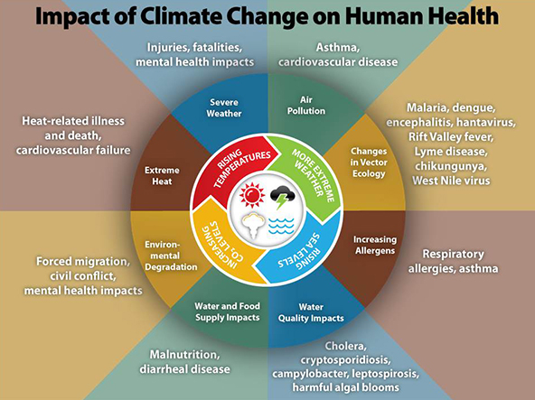
Source: CDC
Notes:
Citation: https://www.cdc.gov/climateandhealth/effects/default.htm

Slide 6
KEY CONCEPTS
Climate Justice
  “Climate change will affect everyone, but not everyone will be affected equally—the effects of climate change will disproportionately impact communities with the least means to adapt, and who have been burdened with negative historic environmental impacts due to institutionalized discriminatory practices” (Dallas Comprehensive Environmental and Climate Action Plan, 2020)
Source: Dallas CECAP
Notes:
Equality is about sameness—meaning that everyone receives the same thing regardless of any other factors. However, equality is only useful if everyone starts from the same place, which is often not the case. Lower income populations and communities of color often have less access to adequate and energy efficient housing, transit, or safe bicycling and walking routes.
Equity, on the other hand, is about fairness, which is about ensuring that people have access to the same opportunities and have what they need to thrive and succeed. Equity is needed before equality can be reached. This understanding recognizes that people may have different starting points and may need different types and levels of support to flourish. Guide to Equitable, Community-Driven Climate Preparedness Planning (The Urban Sustainability
Directors Network, 2019)

Slide 7
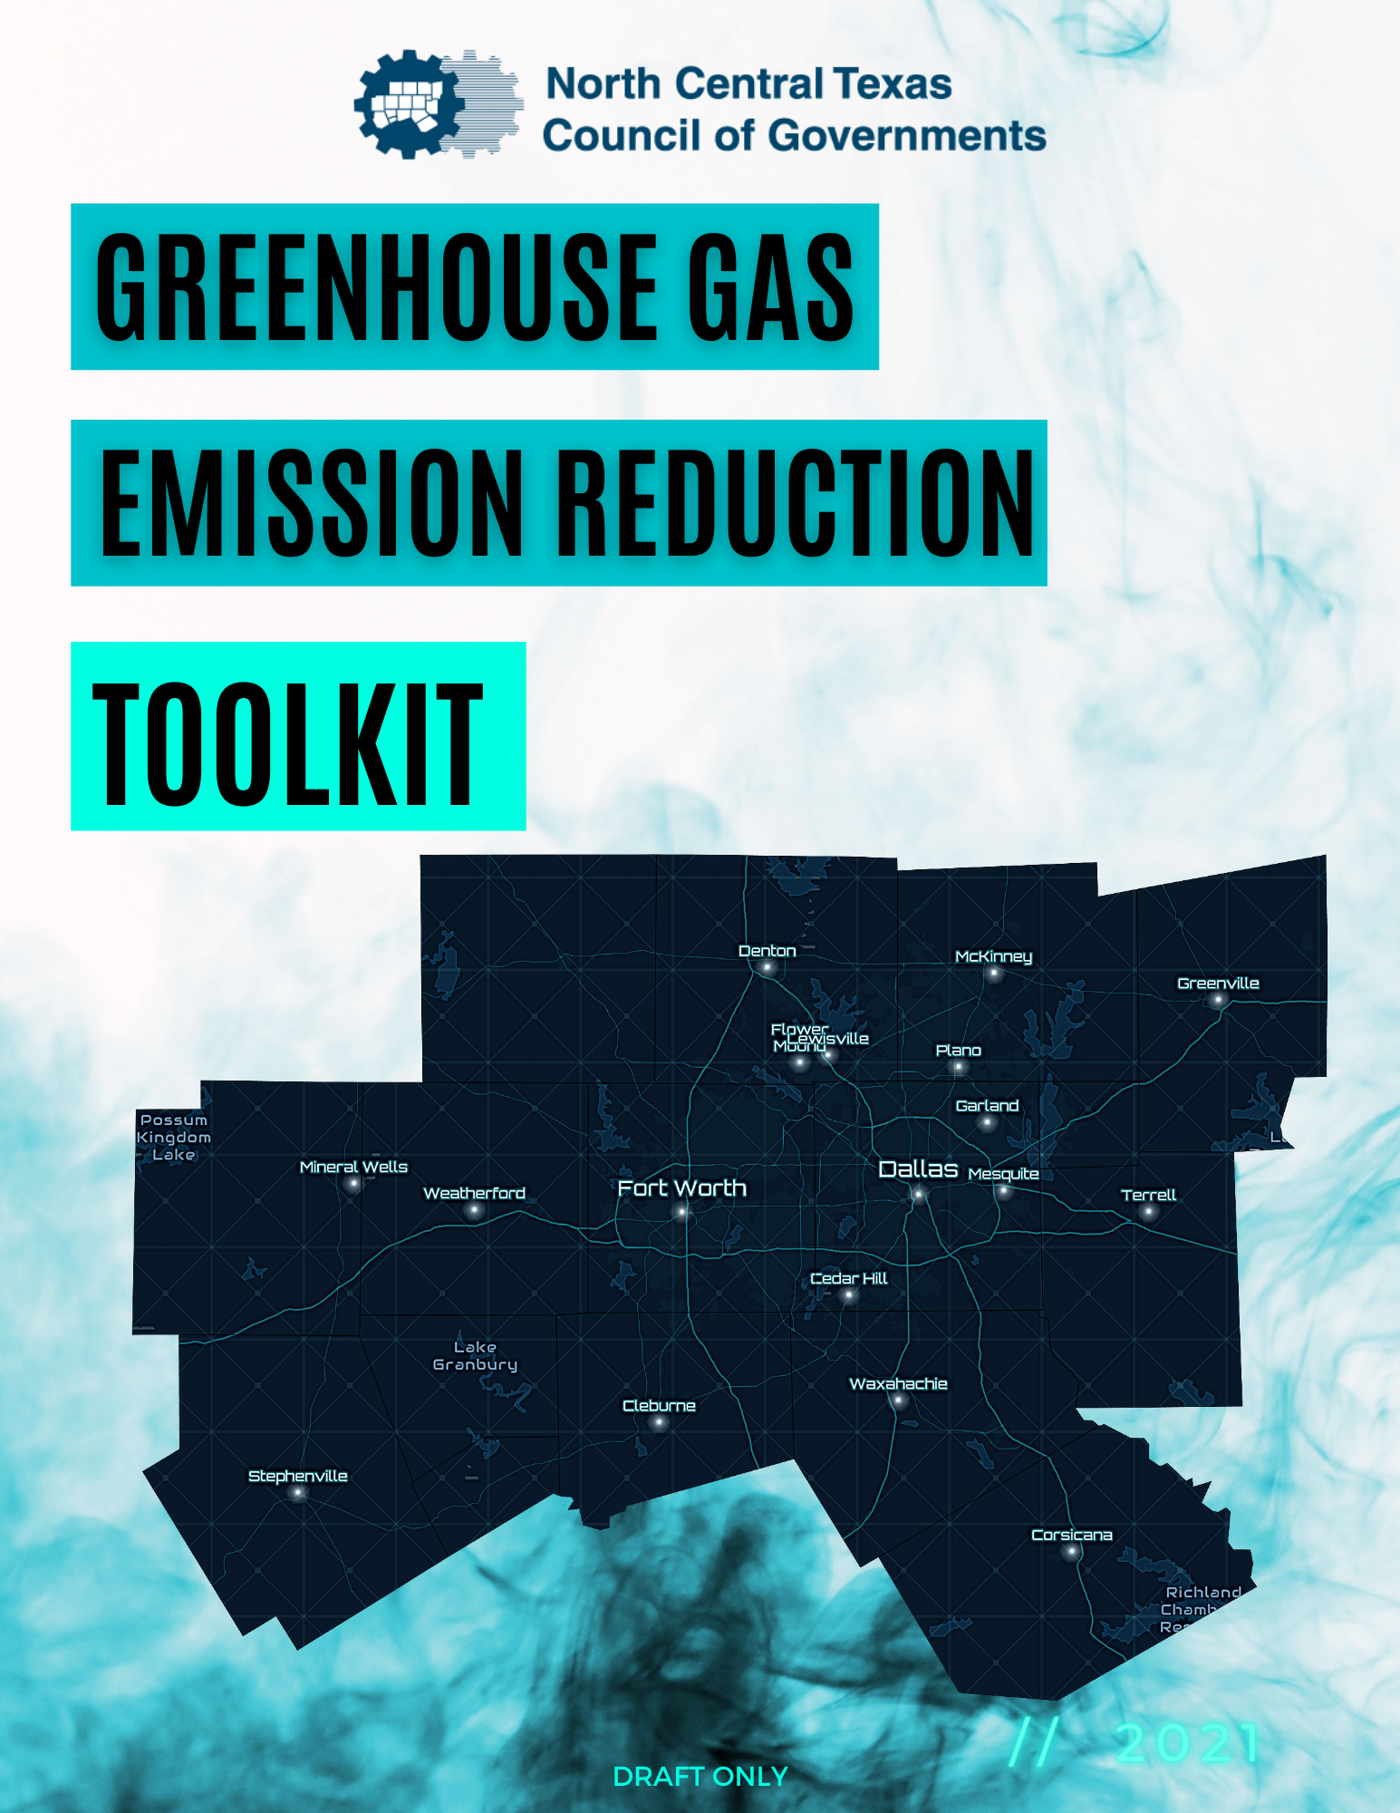
GHG EMISSION REDUCTION TOOLKIT
Inform GHG emission reduction in the Dallas-Fort Worth region
  GHG Toolkit Report
  Strategy Catalogue
  Equitable Community Engagement
Recommend for local government adoption in the Dallas-Fort Worth region
Generate in response to the growing nature of local governments accepting and emphasizing the need to address global climate change through climate risk adaptation, mitigation, and resiliency in the public, private sector, and social sector
zoom
7

Slide 8

OVERBURDENED COMMUNITIES
“Minority, low-income, tribal, or indigenous populations or geographic locations in the United States that potentially experience disproportionate environmental harms and risks. This disproportionality can be a result of greater vulnerability to environmental hazards, lack of opportunity for public participation, or other factors. Increased vulnerability may be attributable to an accumulation of negative or lack of positive environmental, health, economic, or social conditions within these populations or places. The term describes situations where multiple factors, including both environmental and socio-economic stressors, may act cumulatively to affect health and the environment and contribute to persistent environmental health disparities.” – U.S. EPA
Source: U.S. EPA and Resources Provided By U.S. EPA
Notes:
To understand how to equitably mitigate greenhouse gases in Dallas-Fort Worth, we need to understand its historical context that led to certain groups of people being disproportionately burdened by environmental, social, and physical factors – i.e. overburdened.
The story of how Dallas Fort-Worth produced overburdened communities is similar to most U.S. cities, in that they slowly developed through decades of structural and environmental racism. For example, redlining, racial segregation, and serial forced displacement directed groups of people to where they lived and worked which led to concentrations of poverty in predominately black and brown neighborhoods, whose communities perpetuate as environmental injustices today.[20]
This is most prominently seen in the communities of Joppee in Dallas and zip code 76104 in Fort Worth today.
In determining what communities and areas need to be prioritized for GHG emission mitigation, it is necessary to analyze the cumulative impacts of systemic/structural racism, chronic health, and environmental toxins. This analysis was conducted in the following pages using CDC’s PLACES chronic health data], CDC/ATSDR’s Social Vulnerability Index, and EIA data that displays the location of fossil fuel power plants and superfund sites in Dallas Fort-Worth. The goal of this analysis is to identify the top 25 overburdened communities in Dallas-Fort Worth so that they can be prioritized and targeted for mitigation in order to efficiently tackle the communities that will bear the brunt of the adverse effects of climate change.
Emissions from air pollution sources do not impact residents of DFW equally. Exposure to air pollution toxins such as NOx, SO2, VOC, Ozone, and PM2.5 can lead to a plethora of health burdens. For example, one study found that prevalence of asthma and wheezing in relation to residential proximity to an industrial polluter were 98% and 33% odds higher to have those conditions, respectively which demonstrates how air pollution exposure is the leading environmental health risk factor worldwide. That is why the maps on the following pages not only shows chronic disease prevalence but how the prevalence compares to the presence of industrial polluters. With this new perspective, we can now work directly to remedy these health consequences at the source.
Citation: doi: 10.1088/1748-9326/ab35fc and 10.1097/EE9.0000000000000077

Slide 9

CASE STUDY: ZIP CODE 76104
Image Provided By Getty
Notes:
Zip code 76104 which constitutes the neighborhoods of Morningside, Hillside, and Historic Southside. This zipcode is known because ave the lowest life expectancy in the state of Texas: Their residents are estimated to only live to 66.7 years, 12 years less than the national average. What makes the life expectancy of Zip code 76104 more unsettling is that it houses the Fort Worth’s medical district, containing five hospitals and hundreds of outpatient medical offices, but in the just mentioned neighborhoods, there are no doctors offices, clinics, nor pharmacies. What prevents them from receiving adequate health care can only be described through environmental racism – there is a lack of transportation mainly due to a major highway, I-35W cutting north-south through the zip code, which is reminiscent of urban renewal in many major cities that economically debilitated black neighborhoods throughout the country.[23] These disparities were only worsened during the ongoing COVID-19 pandemic where Zip code 76104 had someone of the highest COVID-19 cases per capita.
These two communities are just a sampling of the dozens of communities across dallas fort worth that are already burdened with environmental, social, and infrastructure inequities. So with an added burden of unmitigated greenhouse gases, they will be the ones that suffer the most from its effects. That is what inspired a health equity analysis during this project.
Citation: http://www.theguardian.com/cities/2018/feb/21/roads-nowhere-infrastructure-american-inequality

Slide 10
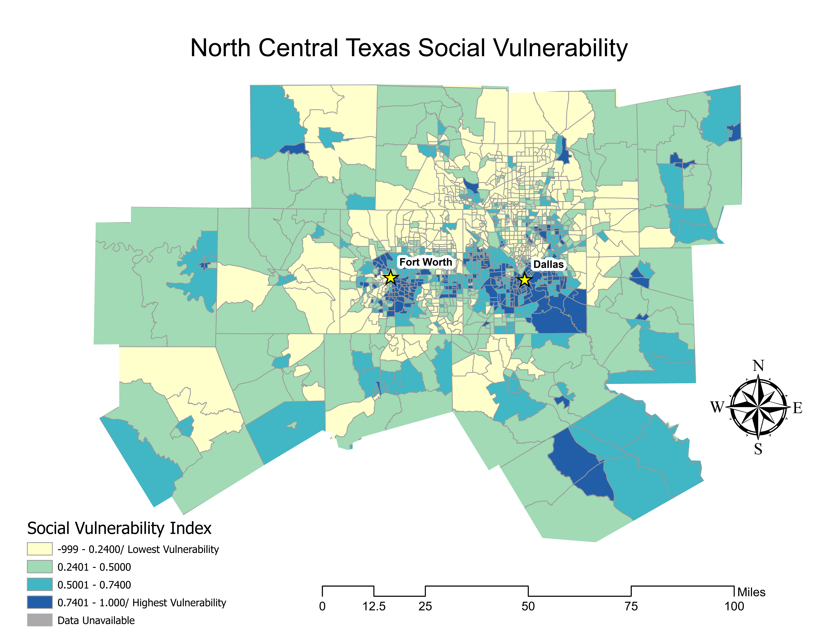
Notes:
We wanted to determine what communities and areas need to be prioritized for GHG emission mitigation. To do that, it is necessary to analyze the cumulative impacts of systemic/structural racism, chronic health, and environmental toxins.
This analysis was conducted using CDC’s PLACES chronic health data[28], CDC/ATSDR’s Social Vulnerability Index[29], and EIA data that displays the location of fossil fuel power plants and superfund sites in Dallas Fort-Worth.
The SVI combines
Socioeconomic status (below poverty, unemployed, income, no high school diploma)
Household composition & disability (aged 65 or older, aged 17 or younger, older than age 5 with a disability, single-parent households)
Minority status & language (minority, speak English “less than well”)
Housing type & transportation (multi-unit structures, mobile homes, crowding, no vehicle, group quarters)
The goal of this analysis is to identify the top 25 overburdened communities in Dallas-Fort Worth so that they can be prioritized and targeted for mitigation in order to efficiently tackle the communities that will bear the brunt of the adverse effects of climate change.
That is why the maps on the following pages not only shows chronic disease prevalence but how the prevalence compares to the presence of industrial polluters. With this new perspective, we can now work directly to remedy these health consequences at the source.

Slide 11
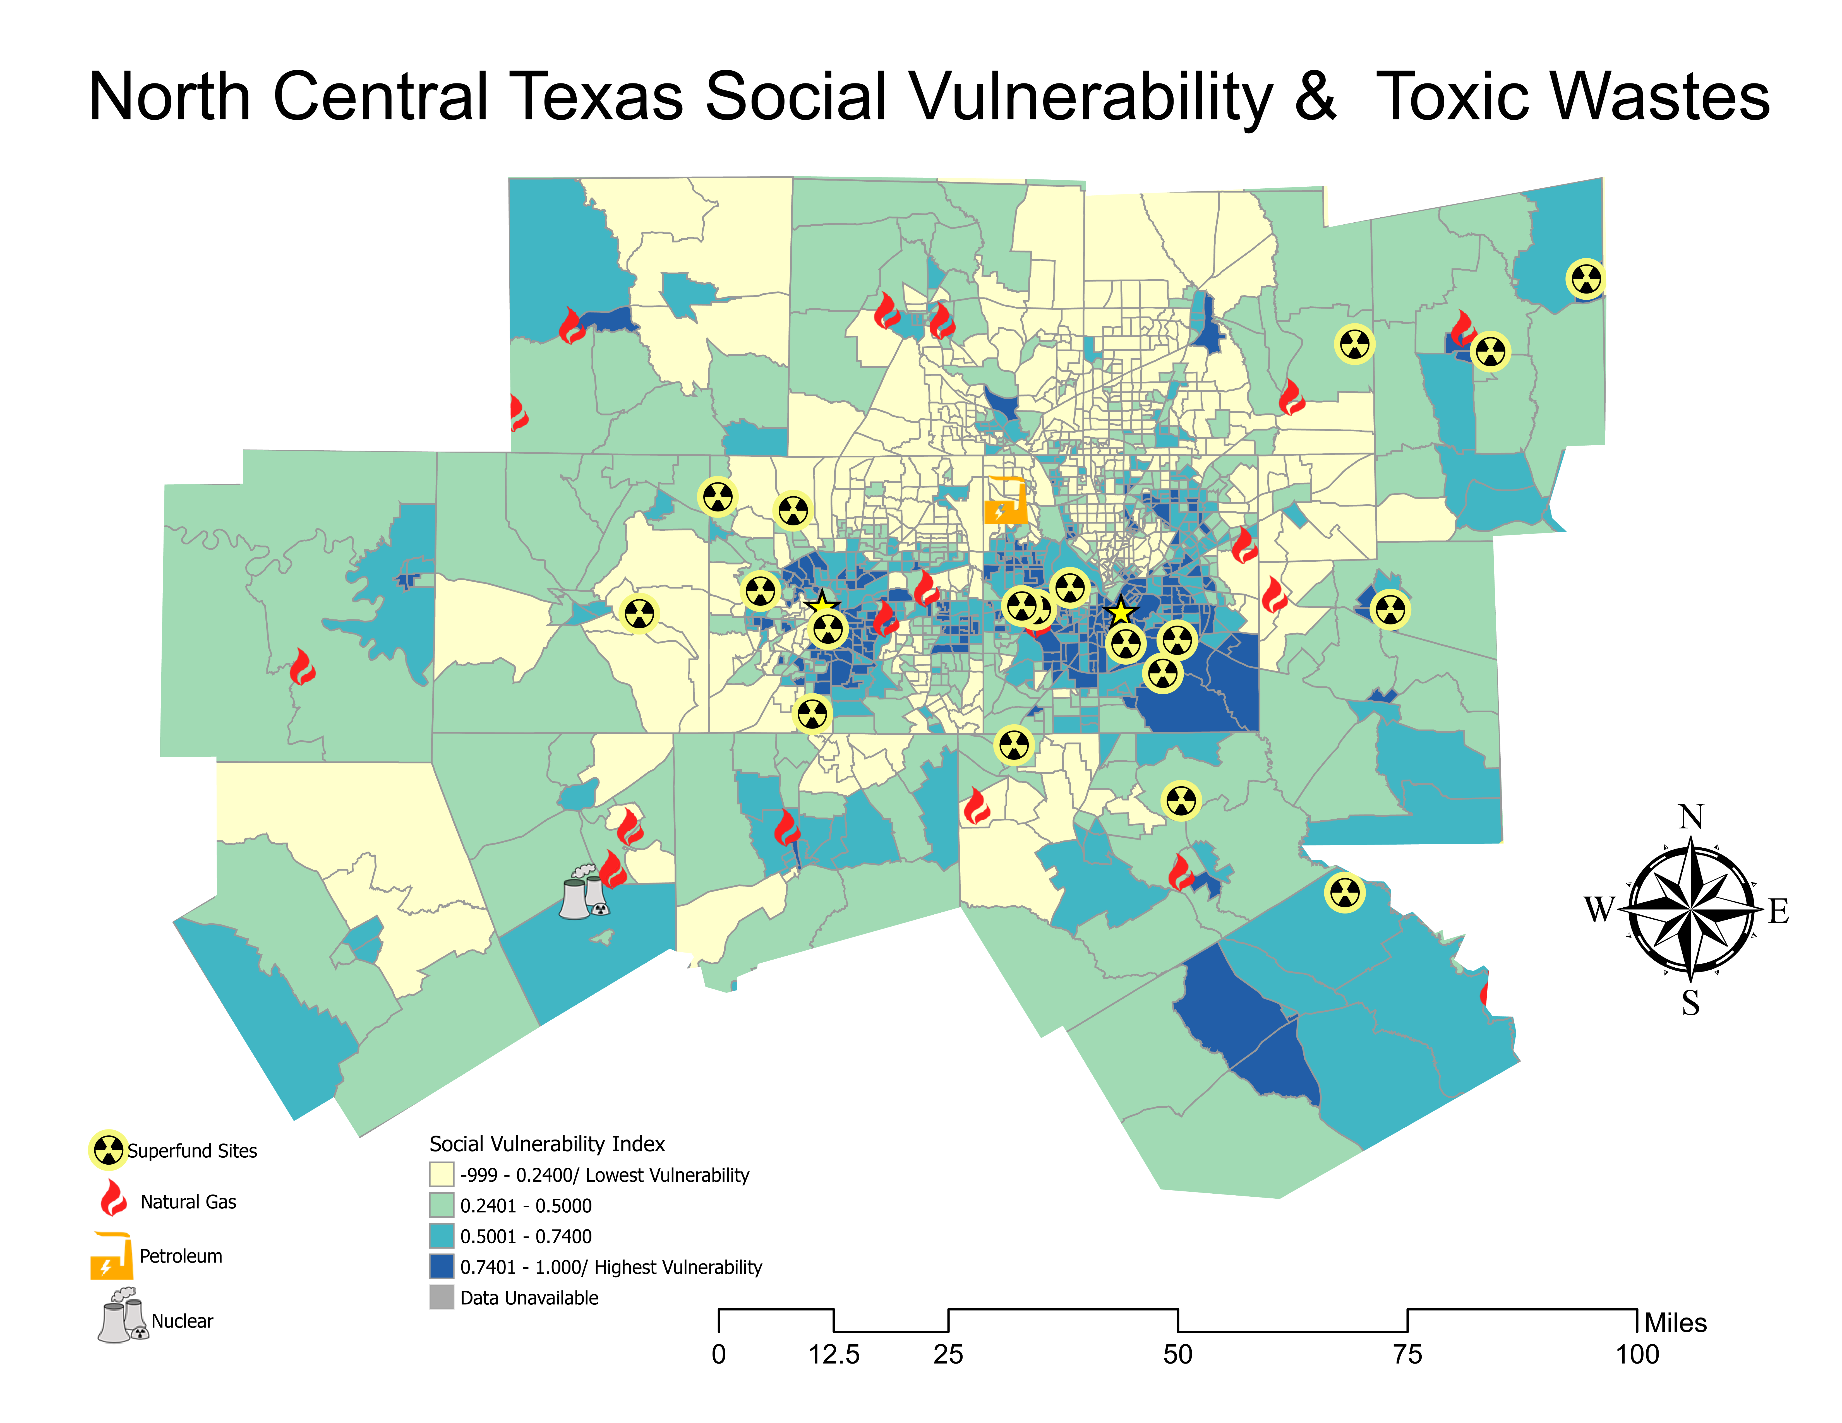

Slide 12
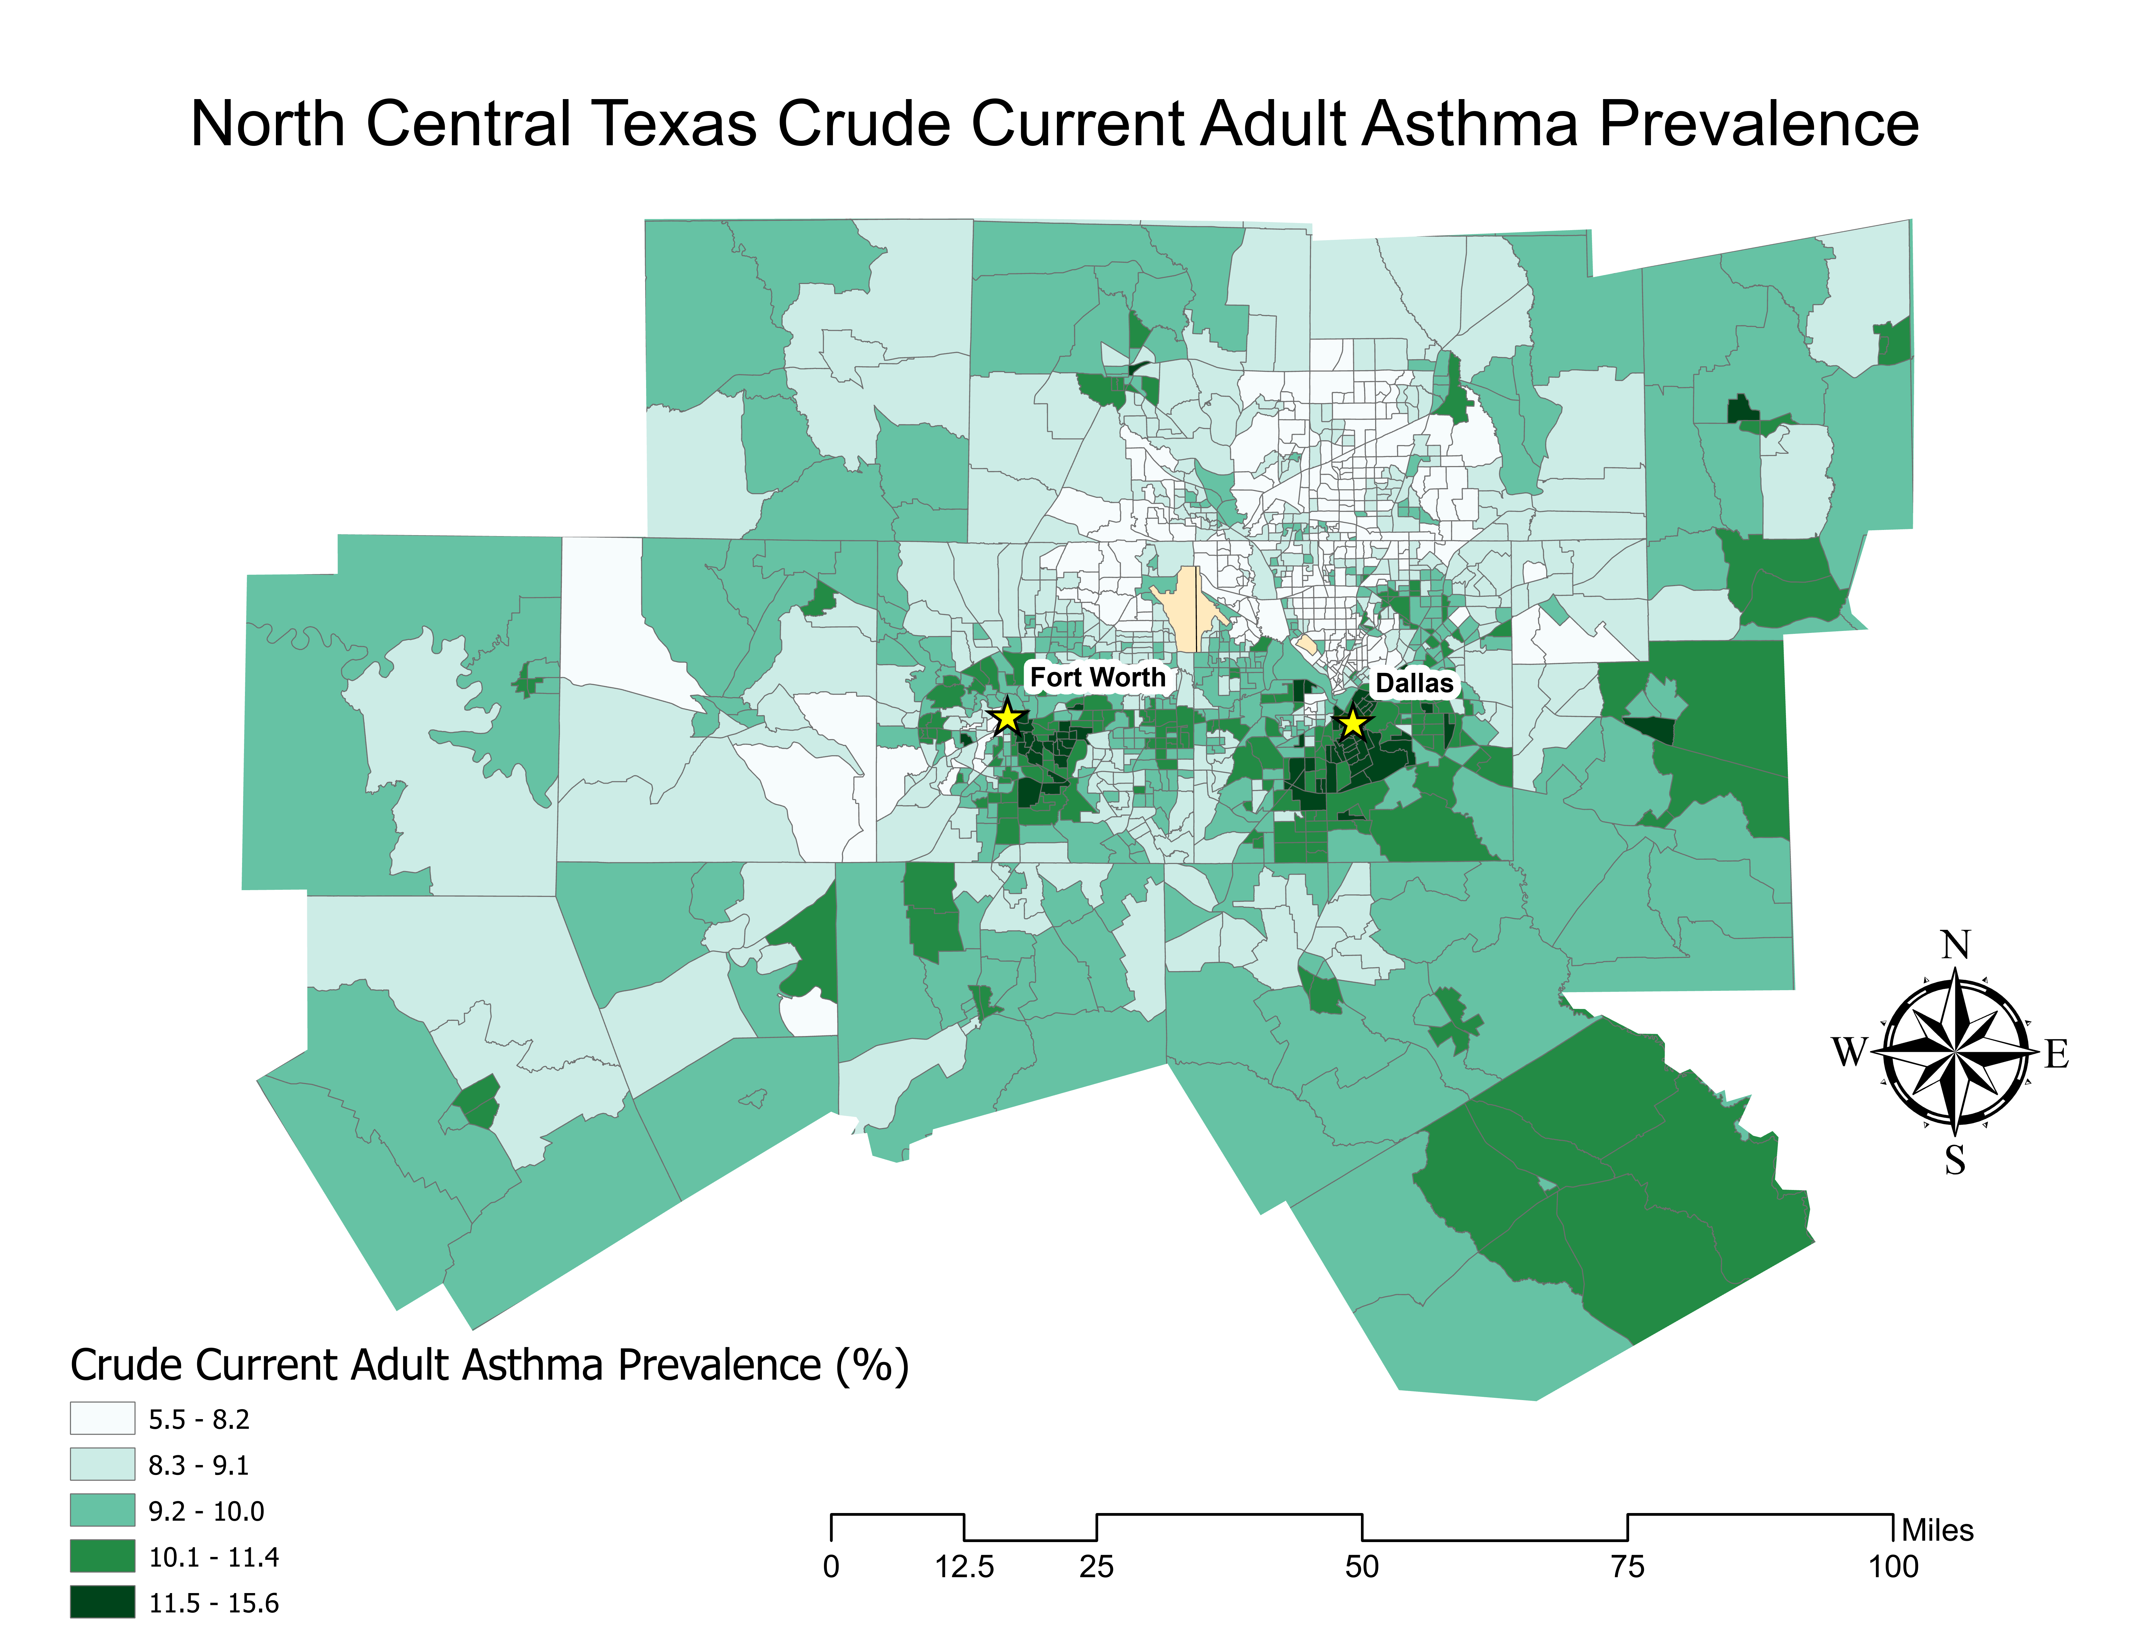

Slide 13
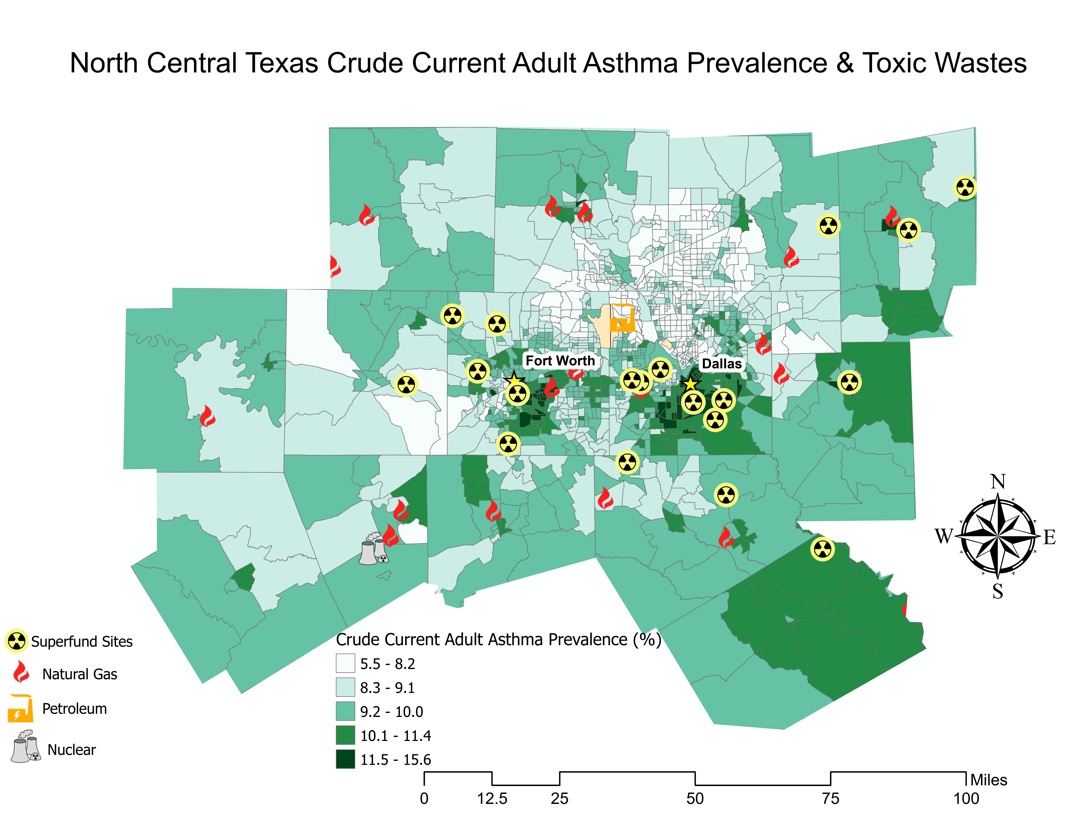

Slide 14
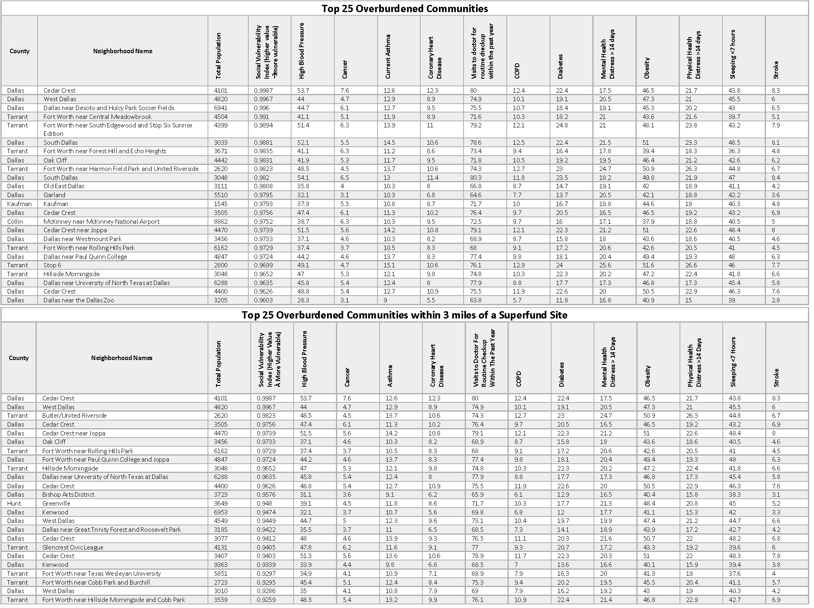
Notes:
The top two communities that are the most overburdened in the region are also within 3 miles of a superfund site

Slide 15
PROPOSED COMMUNITY ENGAGEMENT APPROACH
Internal & External Stakeholder Meetings
Online Marketing
Survey
Send an online survey to capture thousands of public input on GHG emission reduction strategies
Create branding and detail efforts on website while also being advertised on social media platforms
Have a virtual public meeting detailing GHG emission reduction strategies to gain live feedback both internally and externally
Notes:
As a result of these analyses, we are hoping to establish a partnership with a local Historically Black College/University (HBCU), to partner with outreach and engagement to these communities.
Once that pipeline for engagement is established, we were hoping to hold public town halls that will promote open dialogue about each main topic of the toolkit to create an opportunity for community members to share relevant experiences and perspectives from their community.
After this open dialogue, community members will review a draft section of the GHG Emission Reduction toolkit and complete surveys about their relevant experiences.
This overall public engagement and review process is crucial to developing a robust final project that does not contribute to disparities and equitably addresses the needs of overburdened populations. And once this pipeline to overburdened communities is established, it will be translated to other existing and future health equity projects to secure its influence in policies and programming to address socio-economic and health disparities in the Dallas-Fort Worth region.

Slide 16
RESEARCH
Image Provided By Getty
Notes:
With the equity analyses just mentioned as the foundation of the toolkit, now I will be discussing how I took those insights to generate equitable energy related strategies for the GHG Emission Reduction Toolkit

Slide 17
NCTCOG COMMUNITIES RESEARCHED
‘21 ESTIMATED POPULATION COUNT
>50,000 | 50,000-100,000 | 100,000-250,000 | 250,000+
CEDAR HILL DECATUR COPPELL ROCKWALL WAXAHACHIE CORINTH RICHLAND HILLS FARMERS BRANCH | FLOWER MOUND MANSFIELD ROWLETT NORTH RICHLAND HILLS EULESS DESOTO WYLIE GRAPEVINE | DENTON IRVING GRAND PRAIRIE MESQUITE GARLAND FRISCO CARROLLTON RICHARDSON LEWISVILLE ALLEN | DALLAS PLANO ARLINGTON FORT WORTH DFW INTERNATIONAL AIRPORT
Equitably Reducing Greenhouse Gas Emissions through Energy Strategies
Notes:
Researched 33 municipalities within the NCTCOG jurisdiction of very diverse sizes all looking for energy related strategies they implemented in their region
Also looked at several outside cities, regional council of governments, and non-governmental organizations. At the end of this research, which took an entire month to complete, 350 energy related strategies were compiled

Slide 18
ENERGY-RELATED POLLUTION CONTROL SOURCES
AREA SOURCE
POINT SOURCE
AREA SOURCE: OIL & GAS
Ex: Emissions related to building energy usage
Ex: Electric power grid powered by fossil fuels
Ex: Regional landfill methane emissions
NON-ROAD
ON-ROAD
BIOGENICS
Ex: Gasoline and diesel-powered equipment
Ex: Conventional light duty vehicle fleet
Ex: Volatile organic compounds from plants
Notes:
After compiling all these strategies, each strategy was placed into several buckets that represent the pollution source the strategy would remedy. These are area source, oil and gas specific area sources, point source, non-road, on-road, and biogenic emission.
These pollution sources are being targeted for GHG mitigation because they are main contributors to CO2e emissions in this region, but also to criteria air pollutants which is often co-emitted with CO2.
These 350 strategies were also put into categories in terms of different remediation types they account for. After doing that, they were combined, condensed, and synthesized into 30 strategies related to energy usage

Slide 19
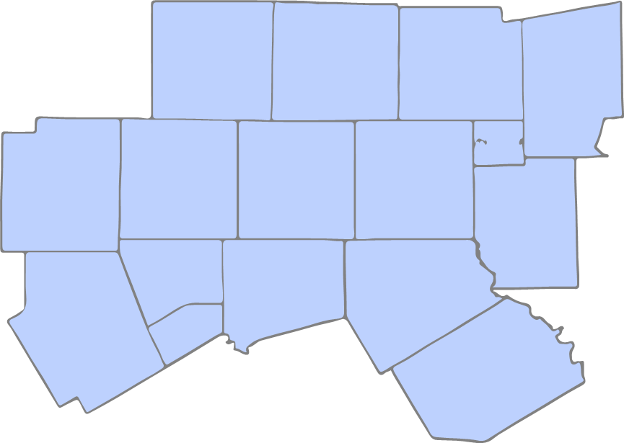
GHG TOOLKIT STRUCTURE
MAIN STRATEGY RECOMMENDATIONS
  Function as an executive summary
  Prioritize greatest emission reductions and equity
INTRODUCTION
  Greenhouse Gases
  Climate Risk Assessment in North Central Texas
  Equity & Overburdened Communities
  Health Equity Analyses
  Strategy Structure & Criteria
SECTOR-SPECIFIC SECTIONS
    Energy, transportation, solid waste, water, buildings, equity, food systems, wastewater
    Strategy emphasis areas → GHG pollution control measures
STRATEGY CATALOGUE
APPENDIX
Resources Provided By Getty ( source for external images only)
Notes:
Now this leads into the toolkit that was generated from all of the research and analyses just mentioned. I was only responsible for the energy section of the toolkit and its overall design, so now I will take you through what I came up with for the energy section

Slide 20
Energy Goal 1: Mitigate Area Source Emissions
E1.1: Building Energy Audit
E1.2: Commercial and Industrial Building Retro-commissioning
Energy Goal 3: Mitigate Point Source Emissions
E3.1: Group Energy Switch & Demand Response Program
E3.6: Zip Code Emission Cap with Buffer Zones and Industrial Polluter Relocation Amortization
Energy Goal 2: Mitigate Oil & Gas Emissions
E2.1: Sustainable Aviation Fuel Initiative
E2.3: Limited Fossil Fuel Infrastructure and Carbon-Free Economy
E1.3: Energy Conservation Ordinance
E1.5: Commercial Solar Energy Development
E1.4: Residential Solar Energy Development
E1.6: Residential Weatherization Assistance Program
E1.8: Urban Heat Island Effect Mitigation
E1.9: Grid Flexibility and Resilience
E1.10: Grid Reliability
E1.7: Utility Assistance Program
E1.11: Energy Efficiency and Renewable Energy Education
E1.12: Tree Planting
E1.13: Equitable Planning and Policymaking Practices
E2.2: Methane & Landfill Gas to Energy Projects
E3.2: Renewable Energy Credits
E3.3: Renewable Energy Infrastructure
E3.4: Renewable Energy Policy Development
E3.5: Air quality Data and Permitting Accessibility
Energy Goal 4: Mitigate Non-road Emission Sources
E4.1: Ground Support Equipment Electrification
E4.2: Electric Vehicle Charging Stations
E4.3: Sustainable and Equitable Pedestrian Infrastructure
Energy Goal 5: Mitigate On-road Emission Sources
E5.1: Fleet Decarbonization Transition
E5.2: Single Occupancy Vehicle Trip Reduction
Energy Goal 6: Mitigate Biogenic Emission Sources
E6.1: Waste to Energy Generation
E6.2: Environmentally Conscious Building Development & Green Infrastructure
E6.3: Public and Private Greenspace Development
Notes:
These are the 30 strategies related to energy usage. They are grouped by overarching goals, which are related to the pollution control source they mitigate
The E is just a code to demonstrate this is an energy strategy as there will be other sections of the toolkit such as transportation, waste, and food that will have different codes to correspond to that section and the numbers correspond to which goal it is and which numbered strategy out of the goal it is
So now I am going to give you a brief tour of the energy section of the GHG Emission Reduction Toolkit!

Slide 21
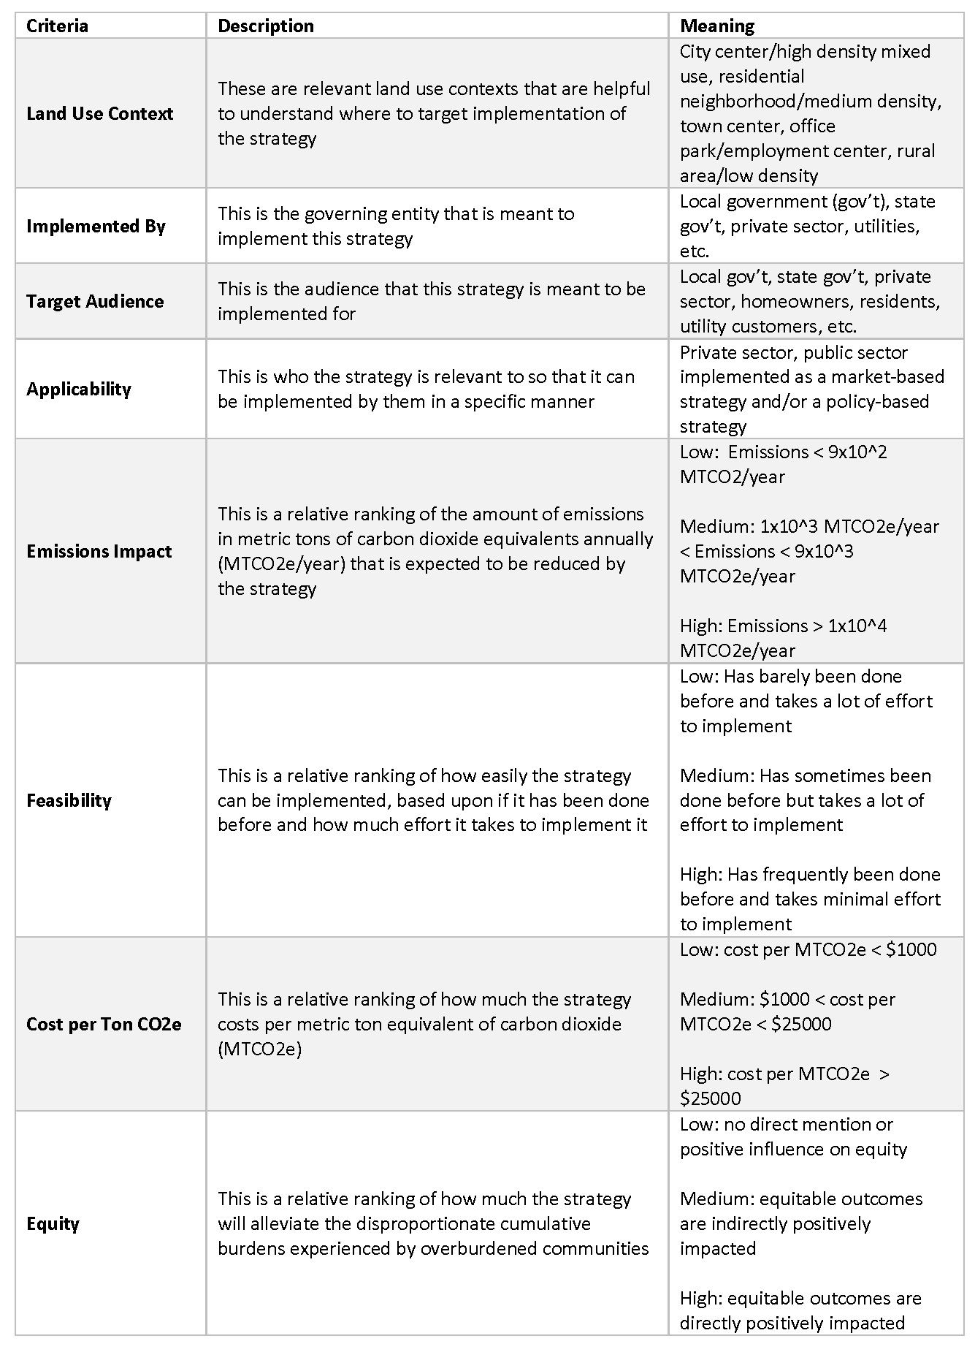

Slide 22
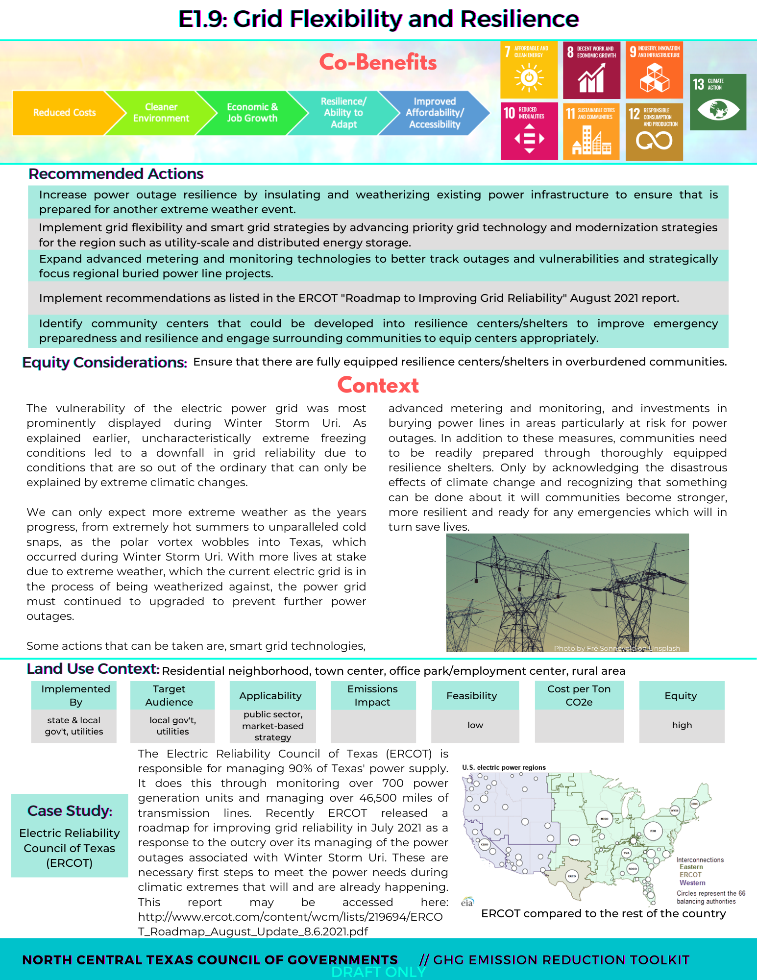
SAMPLE ENERGY STRATEGY PAGE
Resources Provided By Getty ( source for external images only)

Slide 23
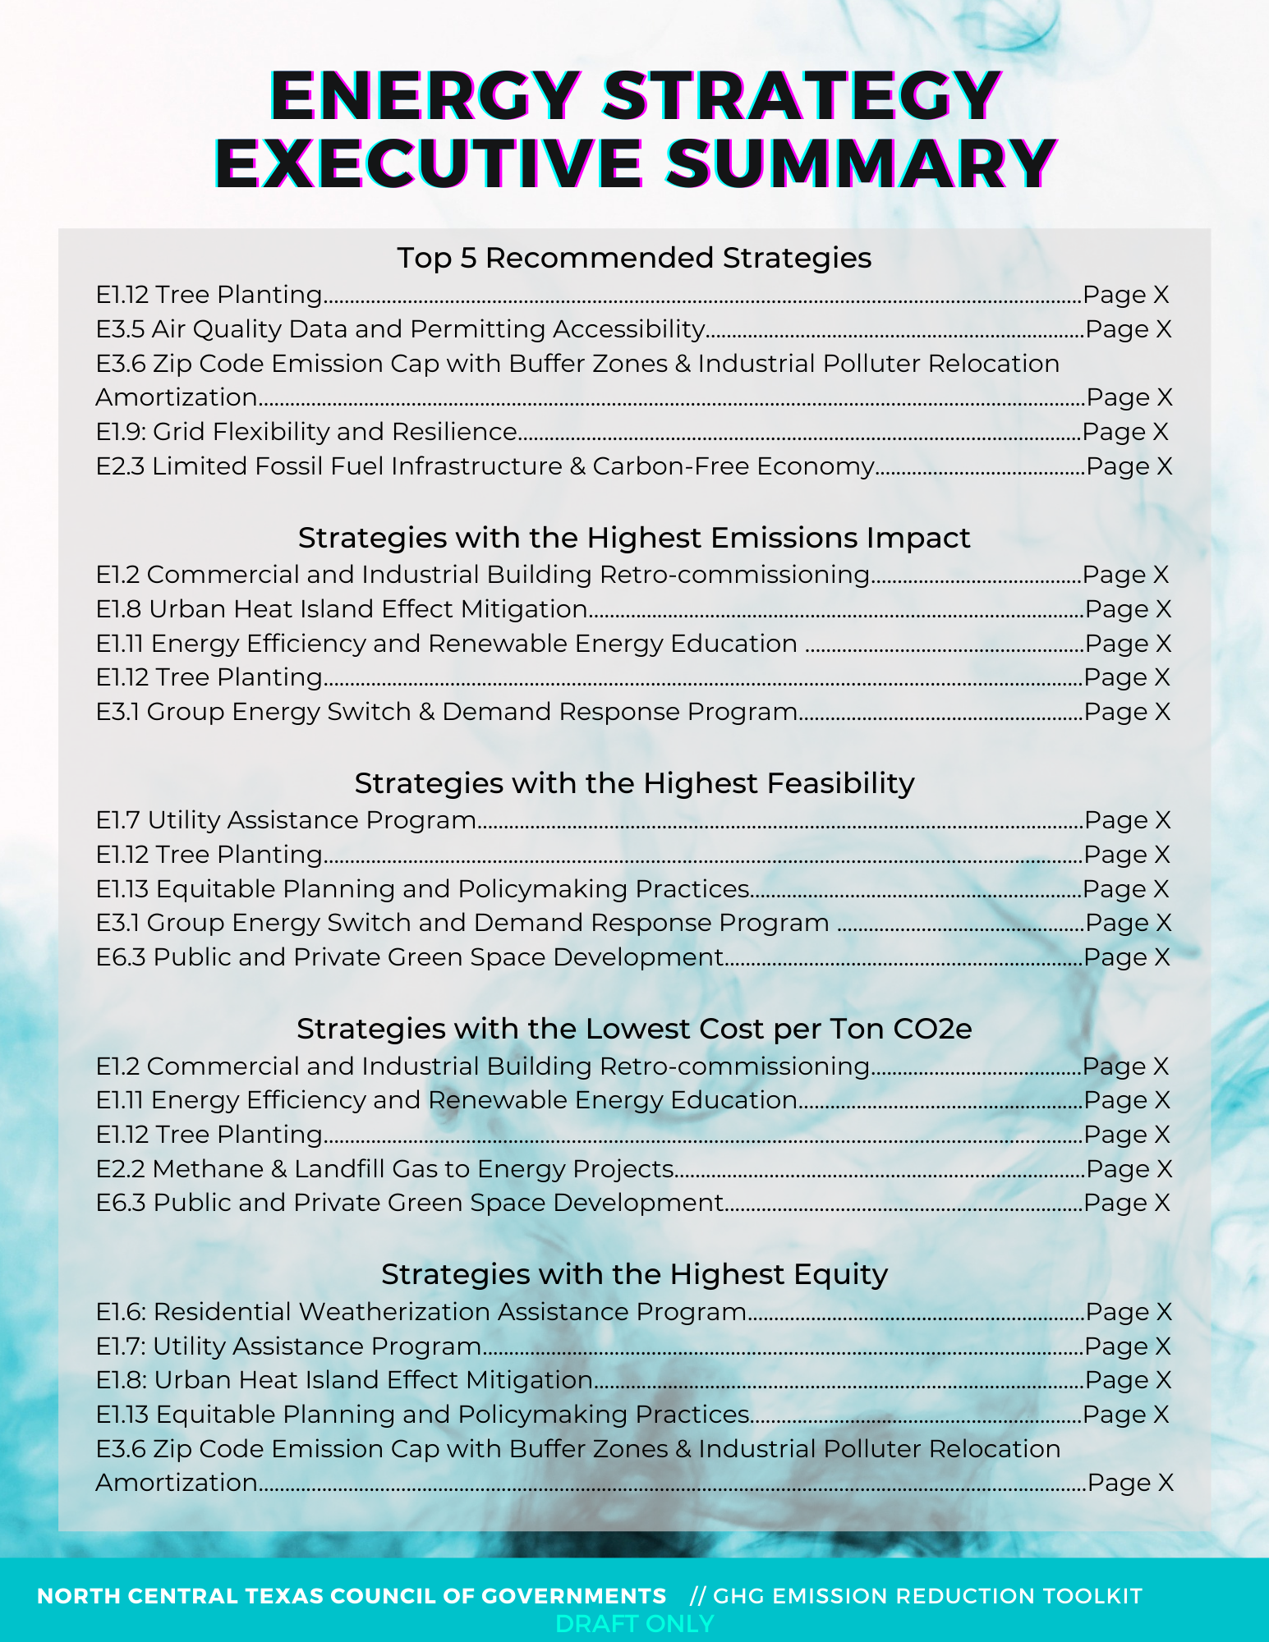
ENERGY STRATEGY EXECUTIVE SUMMARY
Notes:
So that is it with an overview about half of the energy strategies I compiled for the GHG Emission Reduction Toolkit.
As an executive summary,
These top 5 strategies are the ones I recommend for improving the most equity while simultaneously removing the most greenhouse gases and setting up up for a clean energy future and the rest are what will produce the highest emsisions impact, the easiest to do, the lowest cost, and have the highest equity based upon the crude calculations I had completed

Slide 24
ADDITIONAL TOOLS FOR STATE GOVERNMENTS, LOCAL GOVERNMENTS & THE PRIVATE SECTOR
Strategy Catalogue
Resource Bank
Image Provided By Getty

Slide 25
CONCLUSION & NEXT STEPS
GHG mitigation must be a priority in the Dallas Fort Worth region → co-benefits
Finish the Regional GHG Inventory and set Science-Based Targets for regional GHG reductions → carbon law aligned
Finish the Greenhouse Gas Toolkit with sector-specific sections
Implement a public review process (townhalls, surveys, website) and collaborate with a HBCU or community organization to partner with overburdened communities

Slide 26

CONTACT US
Lauren Johnson
‘21 Environmental Defense Fund Climate Corps Fellow
lsjohnson@gwu.edu| Linkedin: @lauren-johnson-wustl/
Jenny Narvaez
Program Manager, Air Quality Management
jnarvaez@nctcog.org | 817-608-2342

